Slide 1
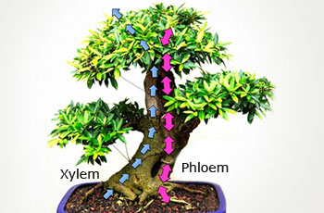
Modeling Water Flow in Plants
Sergiy Koshkin
UHD Mathematics and Statistics
NSF REU grant #1560401

Slide 2

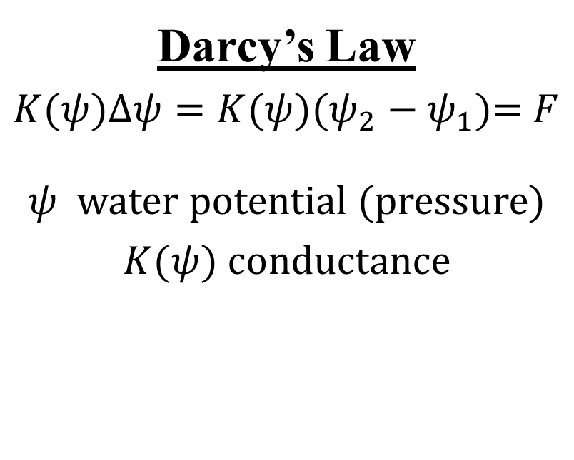

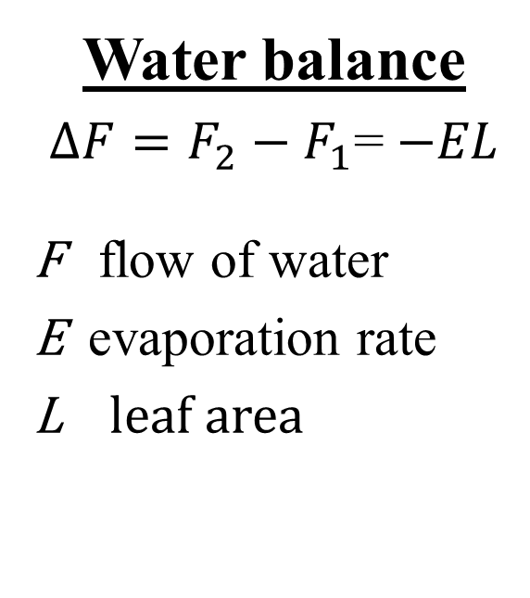




Plant Hydraulics
Water balance
$∆F=F_{2}−F_{1}$= $−EL$
F flow of water
E evaporation rate
L leaf area
Darcy’s Law
$K(ψ)∆ψ={K(ψ)(ψ}_{2}−ψ_{1}$)= $F$
$ψ$ water potential (pressure)
$K(ψ)$ conductance
$$EL$$
$$ψ_{2}$$
$$F_{2}$$
$$F$$
$$F_{1}$$
$$ψ_{1}$$

Slide 3
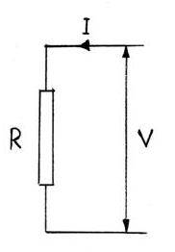
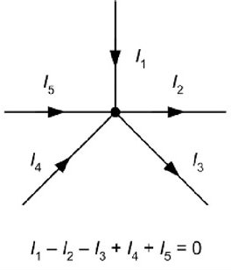
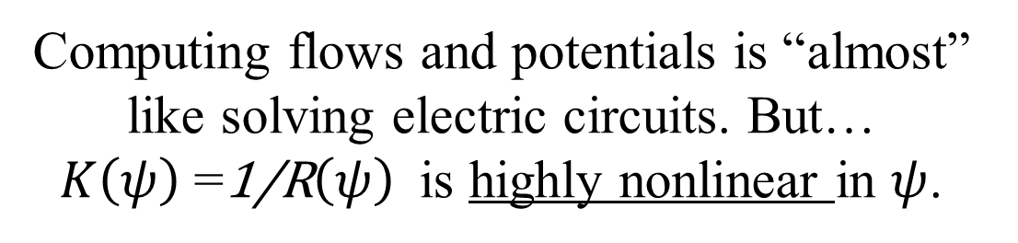
Electric Circuit Analogy
Kirchhoff’s current law
Ohm’s law
Computing flows and potentials is “almost” like solving electric circuits. But… $K\left(ψ\right)$=1/R$\left(ψ\right)$ is highly nonlinear in $ψ$.

Slide 4
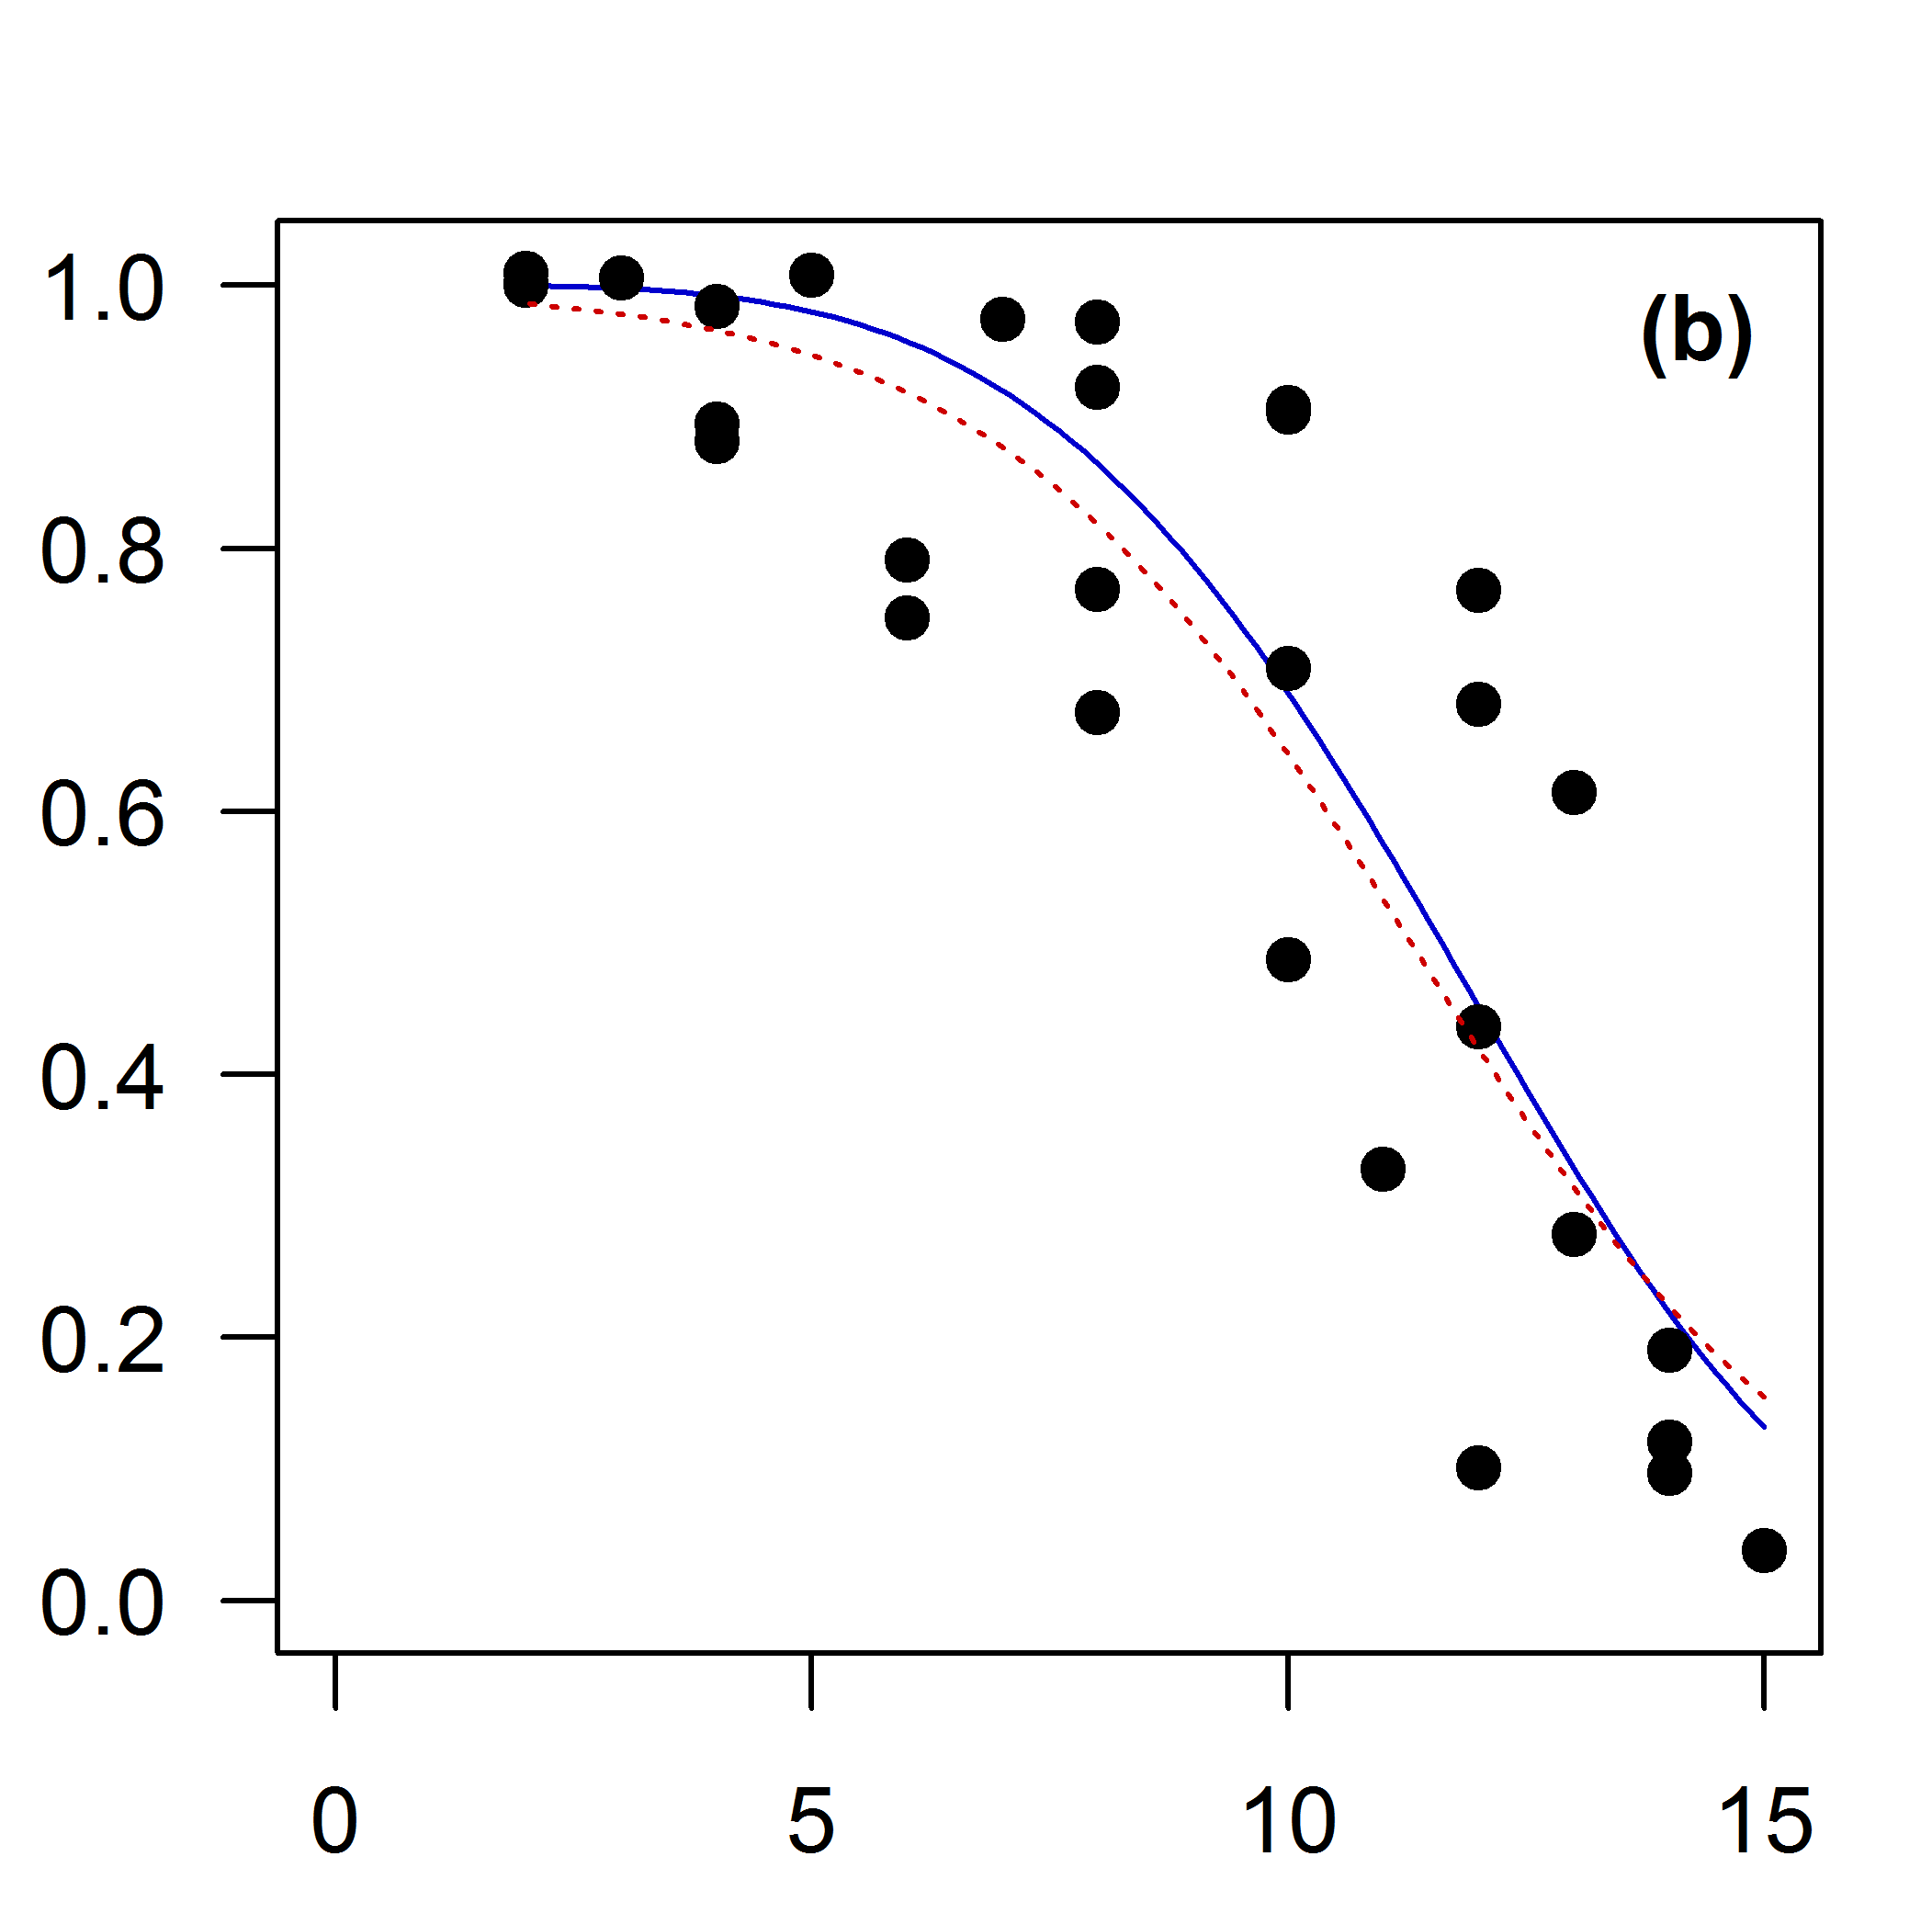

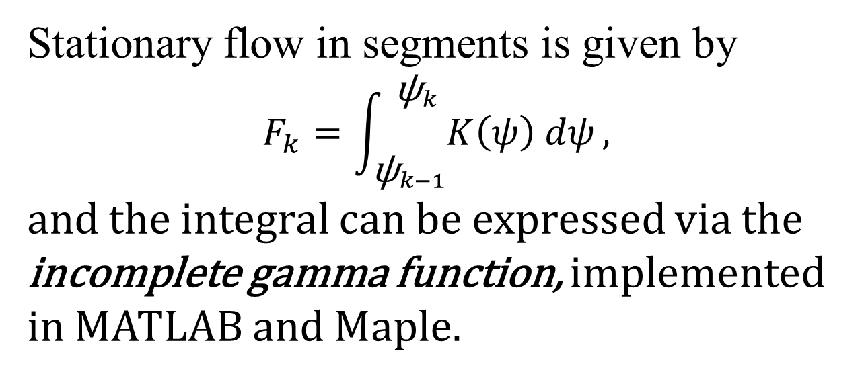
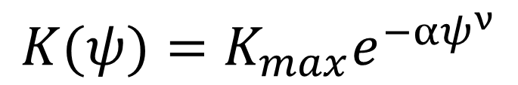

Vulnerability Curves
$$K(ψ)=K_{max}e^{−αψ^{ν}}$$
Weibull function fit:
$$K$$
Stationary flow in segments is given by
$$F_{k}=\int_{{\text{ѱ}}_{k−1}}^{ {\text{ѱ}}_{k}}{K\left(ψ\right) dψ},$$
and the integral can be expressed via the
incomplete gamma function, implemented
in MATLAB and Maple.
$$ψ$$

Slide 5
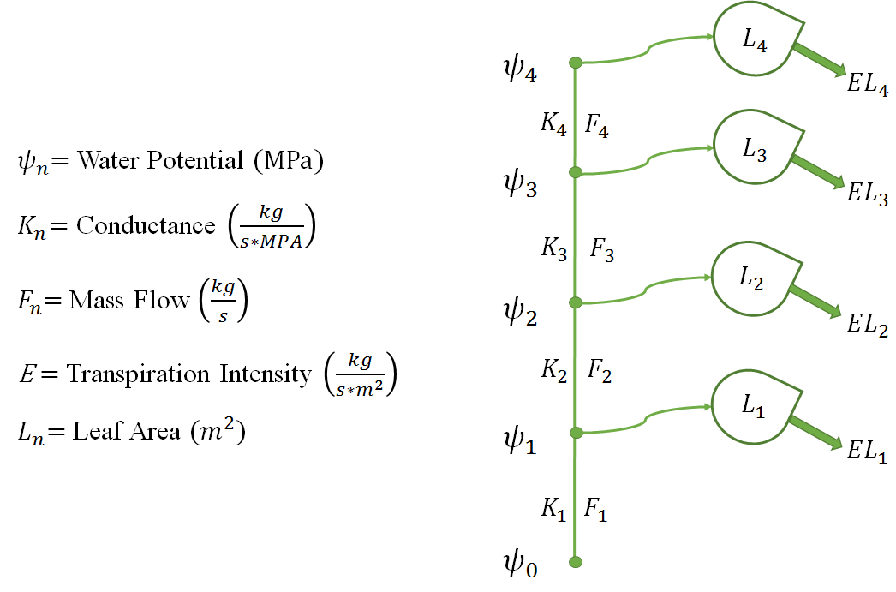
Assembling the model

Slide 6


Richards equation
The truth holds partial derivatives… and time.
Water balance $F=k(ψ)\frac{∂ψ}{∂x}$ and Darcy’s law $\frac{∂F}{∂x}=−EL δ\left(x\right)+c\frac{∂ψ}{∂t}$
combine into the Richards equation:
$$c\frac{∂ψ}{∂t}=\frac{∂}{∂x}k(ψ)\frac{∂ψ}{∂x}+EL δ(x)$$
This is a diffusion equation, but non-linear, unlike classical ones
It is set on a graph (of a plant), not a classical domain

