Slide 1
Modeling Whole Plant Water Transport: Introduction to Plant Hydraulics
Michael Tobin
Natural Sciences Department
University of Houston-Downtown

Slide 2
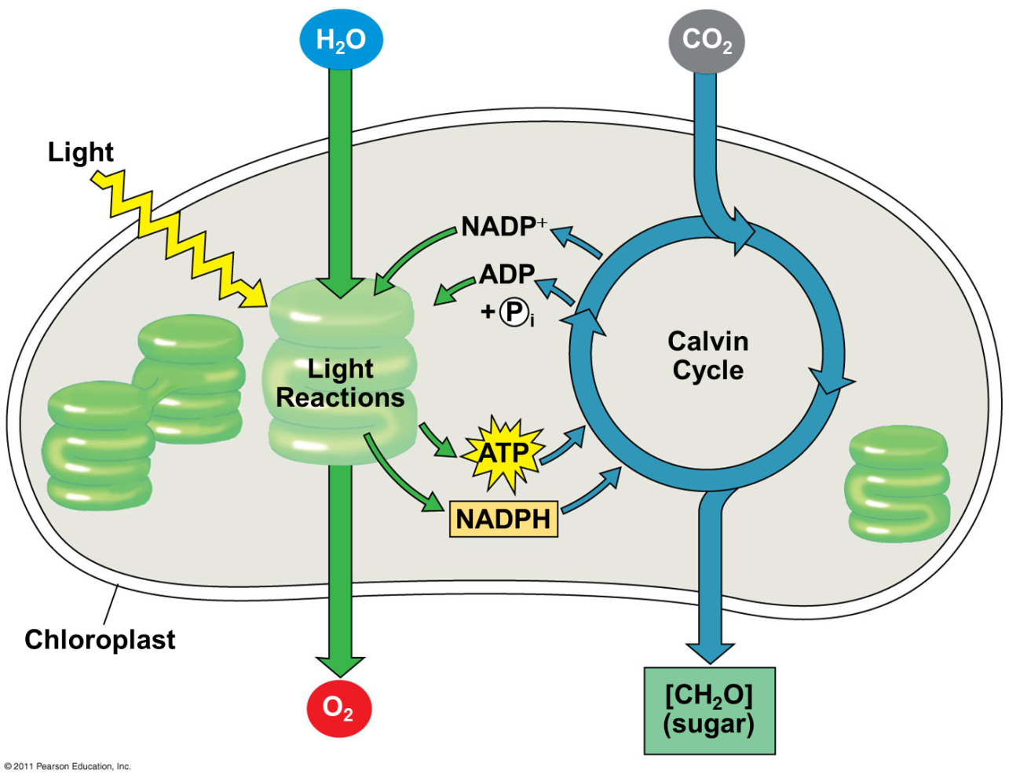
Photosynthesis
Notes:
Most of the biologically available energy in the biosphere is derived from the conversion of sunlight into energy-rich carbon compounds.
Photosynthesis produces oxygen, which is released into the atmosphere.
Photosynthesis removes CO₂ from the atmosphere and reduces it into sugars, which are used as the building blocks for plant growth and energy for metabolism
Photosynthesis occurs in chloroplasts, but where are chloroplasts located in the plant?

Slide 3
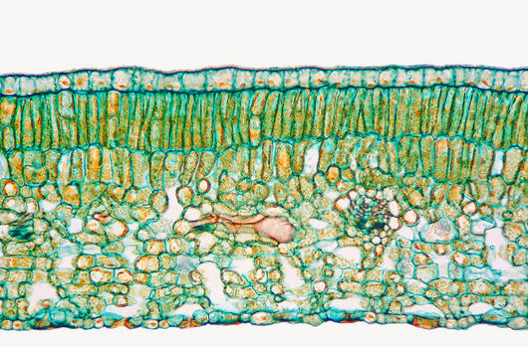
Spongy parenchyma
Palisade parenchyma
Upper
epidermis
Vascular bundle (vein, xylem & phloem)
Stomate
Lower
epidermis
Intercellular air spaces
Science photo library
Notes:
This is a cross section of a leaf
Chloroplasts are concentrated in the top layer of the leaf called the palisade parenchyma, but they occur throughout the parenchyma.
Remember that CO₂ is fixed into organic molecules as part of photosynthesis.
How does CO₂ get to the chloroplasts?
CO₂ diffuses into the leaf via stomata, which are pore-like structures in the epidermal layer of leaves.
It then moves through intercellular airspaces to cells containing chloroplasts.

Slide 4
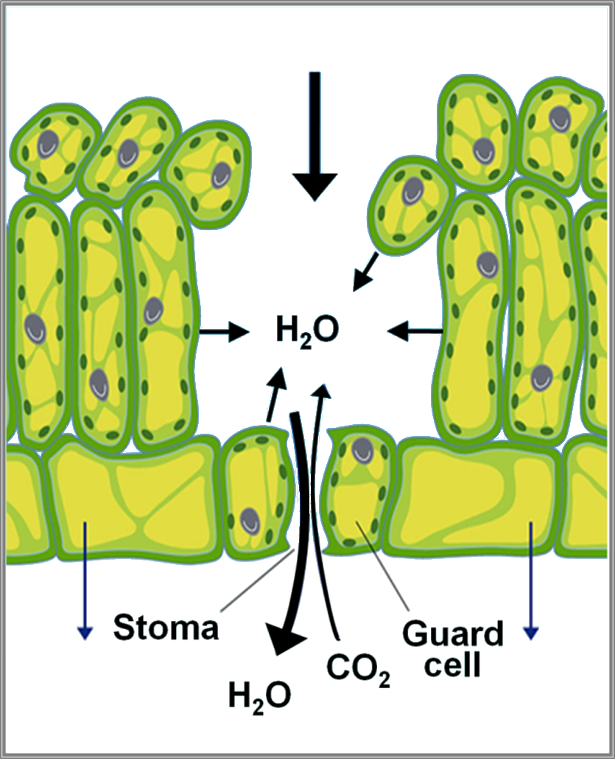
Linking photosynthesis and water transport
transpiration
Notes:
Here, now, is the link between photosynthesis and water transport.
As plants open stomata to allow carbon dioxide uptake water vapor from inside the leaf diffuses out.
Water loss from leaves is an inevitable consequence of carbon dioxide uptake. It can’t be avoided.
How is water supplied to the leaf?

Slide 5
Cohesion-Tension Theory of Water Transport

Slide 6
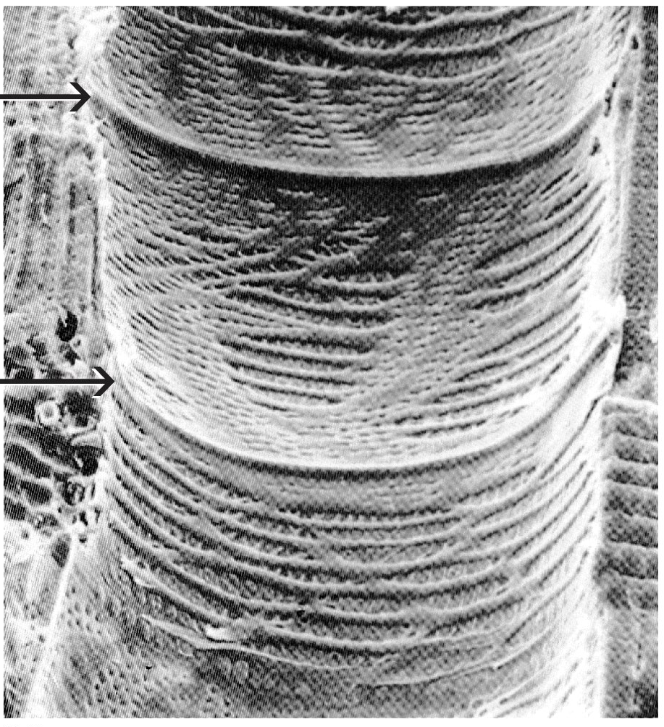
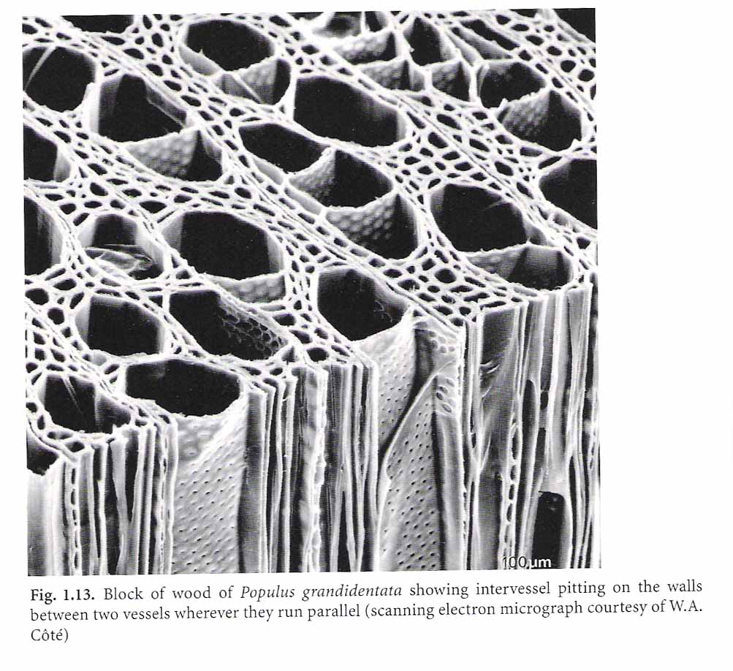

Slide 7
pit
Notes:
Slide 22: SEM pit membrane pic
Pits are gaps in the lignifed secondary cell walls through which vessels are connected to one another.
This is a SEM of two vessels running side by side in a bottle tree.
For water to move from vessel to the next it must go through the pit membranes - which you can see in the centre of the pit cavity.

Slide 8
Cohesion-Tension Theory of Water Transport
What happens when the soil begins to dry out?

Slide 9
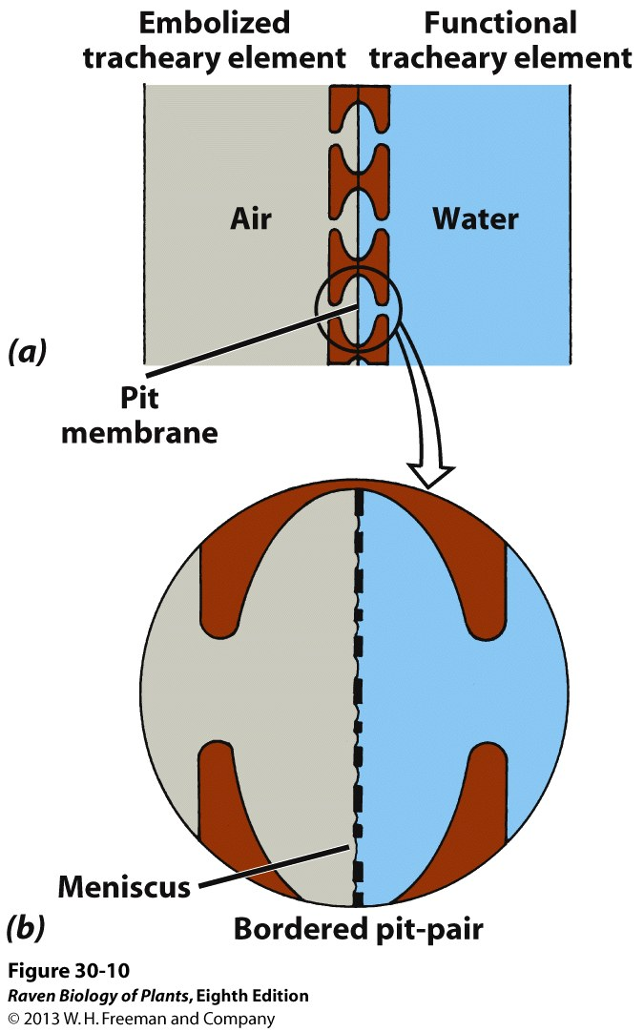
Air seeding hypothesis

Slide 10
Air seeding hypothesis
Notes:
At a critical negative pressure, air can be sucked into vessels which blocks them to further water transport.

Slide 11
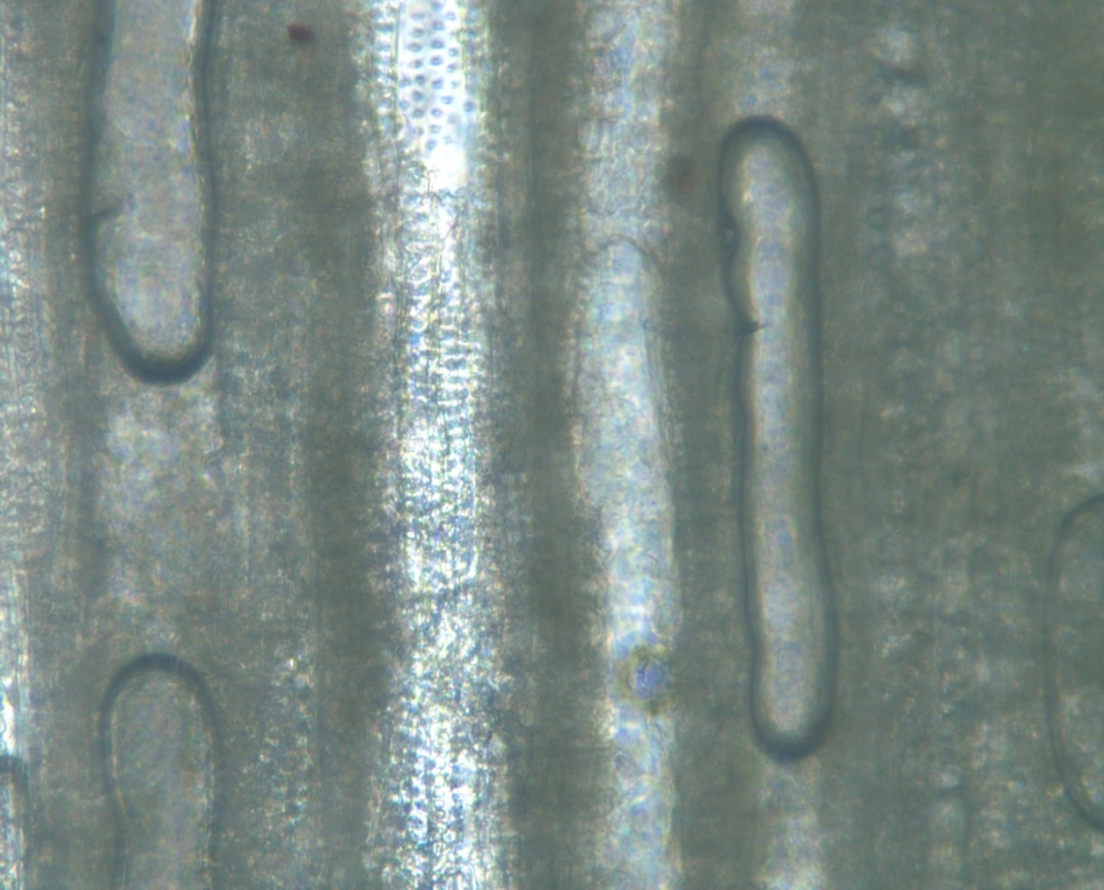
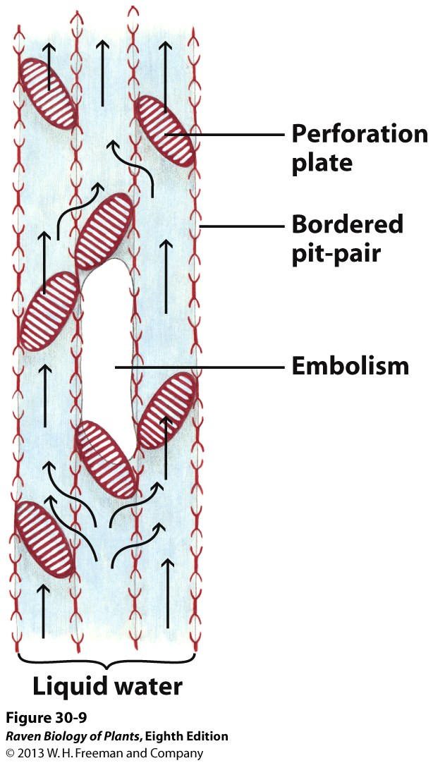
Photo: A.L. Jacobsen
Air emboli will reduce conductance (transport efficiency)
Notes:
Here you can see air bubbles that have formed in the xylem.
As more vessels in a stem become filled with air, the stems ability to transport water is compromised.
The negative pressure that causes complete xylem failure differs dramatically between different species of plants.
In other words, some plant species can maintain function through extreme dehydration but other cannot.

Slide 12
Vulnerability Curves
Ceanothus leucodermis

Slide 13
Questions?

