Slide 1
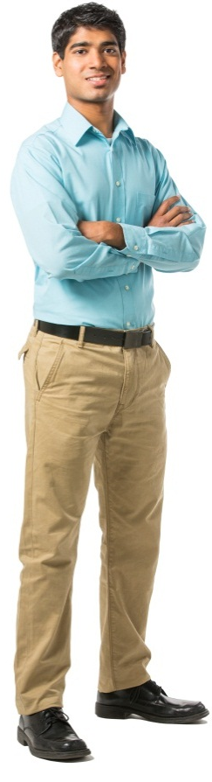

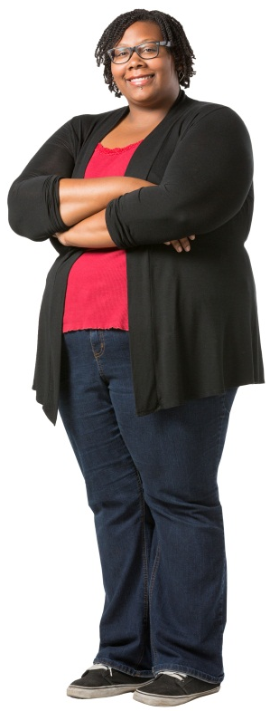


Advancement & University Relations
Website Redesign Update
March 4, 2014

Slide 2
UHD Website Redesign
RFP Distributed Feb, 2013
Vendor responses Mar, 2013
Vendor presentations May, 2013
Vendor selected June, 2013
Contract finalized Oct, 2013
Project initiated Nov, 2013
Stakeholder survey Nov, 2013

Slide 3
Stakeholder Survey
Surveys emailed to faculty/staff and to students in Nov
Survey closed November 20
Student responses: 198
Faculty staff responses: 174
Total Responses: 372

Slide 4
User Snapshot: Visit Frequency
Q: Not including internal-only resources such as Blackboard, how often do you visit uhd.edu?
Student N=176, Faculty/Staff N=154

Slide 5
User Snapshot: Device Usage
Q: What type(s) of devices do you use to access uhd.edu? Student N=176, Faculty/Staff N=154

Slide 6
User Snapshot: Most Frequent Location
Q: Do you visit uhd.edu most often from on-campus or off-campus? Student N=177, Faculty/Staff N=153

Slide 7
User Snapshot: Social Engagement
Q: Do you follow/like any UHD-related entities on the following social media properties? Student N=84, Faculty/Staff N=32

Slide 8
Stakeholder survey results
FACULTY/STAFF
More frequent users
Visit from on-campus
Follow UHD on Facebook, with higher Twitter usage
STUDENTS
More mobile
Visit more from off-campus
Follow UHD on Facebook

Slide 9
User Snapshot Takeaways
Emphasize student-focused resources on mobile version of site
Consider ways to present content differently for on-campus users, especially faculty & staff
Capitalize on high social media engagement with Facebook and Twitter integration

Slide 10
Top Priority Audience
Q: If you had to select a single web audience that you would consider to be your top priority, which would it be? Faculty/Staff N=132

Slide 11
Top Usage Reasons
Q: For which reasons have you visited uhd.edu in the past month? Student N=166, Faculty/Staff N=136

Slide 12
Was your most recent visit successful?
Q: Would you consider your most recent visit to uhd.edu to be “successful”? In other words, were you able to find the information you were looking for? Student N=177, Faculty/Staff N=150

Slide 13
Top Areas of Improvement
Q: Which of the following aspects of uhd.edu would you most like to see improved? Please select your top 3 priorities. Student N=173, Faculty/Staff N=150

Slide 14
Relaunch Priorities Takeaways
Constituents are finding information, but have some frustration getting there; revising the information architecture can help
Focus on getting things done
Improve search functionality
Consider how the relaunch can impact / influence other UHD systems such as MyUHD

Slide 15
CMS priorities
Q: In what way would you most like to see information updating on uhd.edu improved? Faculty/Staff N=48

Slide 16
CMS Priorities Takeaways
Editors confirmed that they want “all of the above”
The new implementation of SharePoint should meet all of
these needs

Slide 17
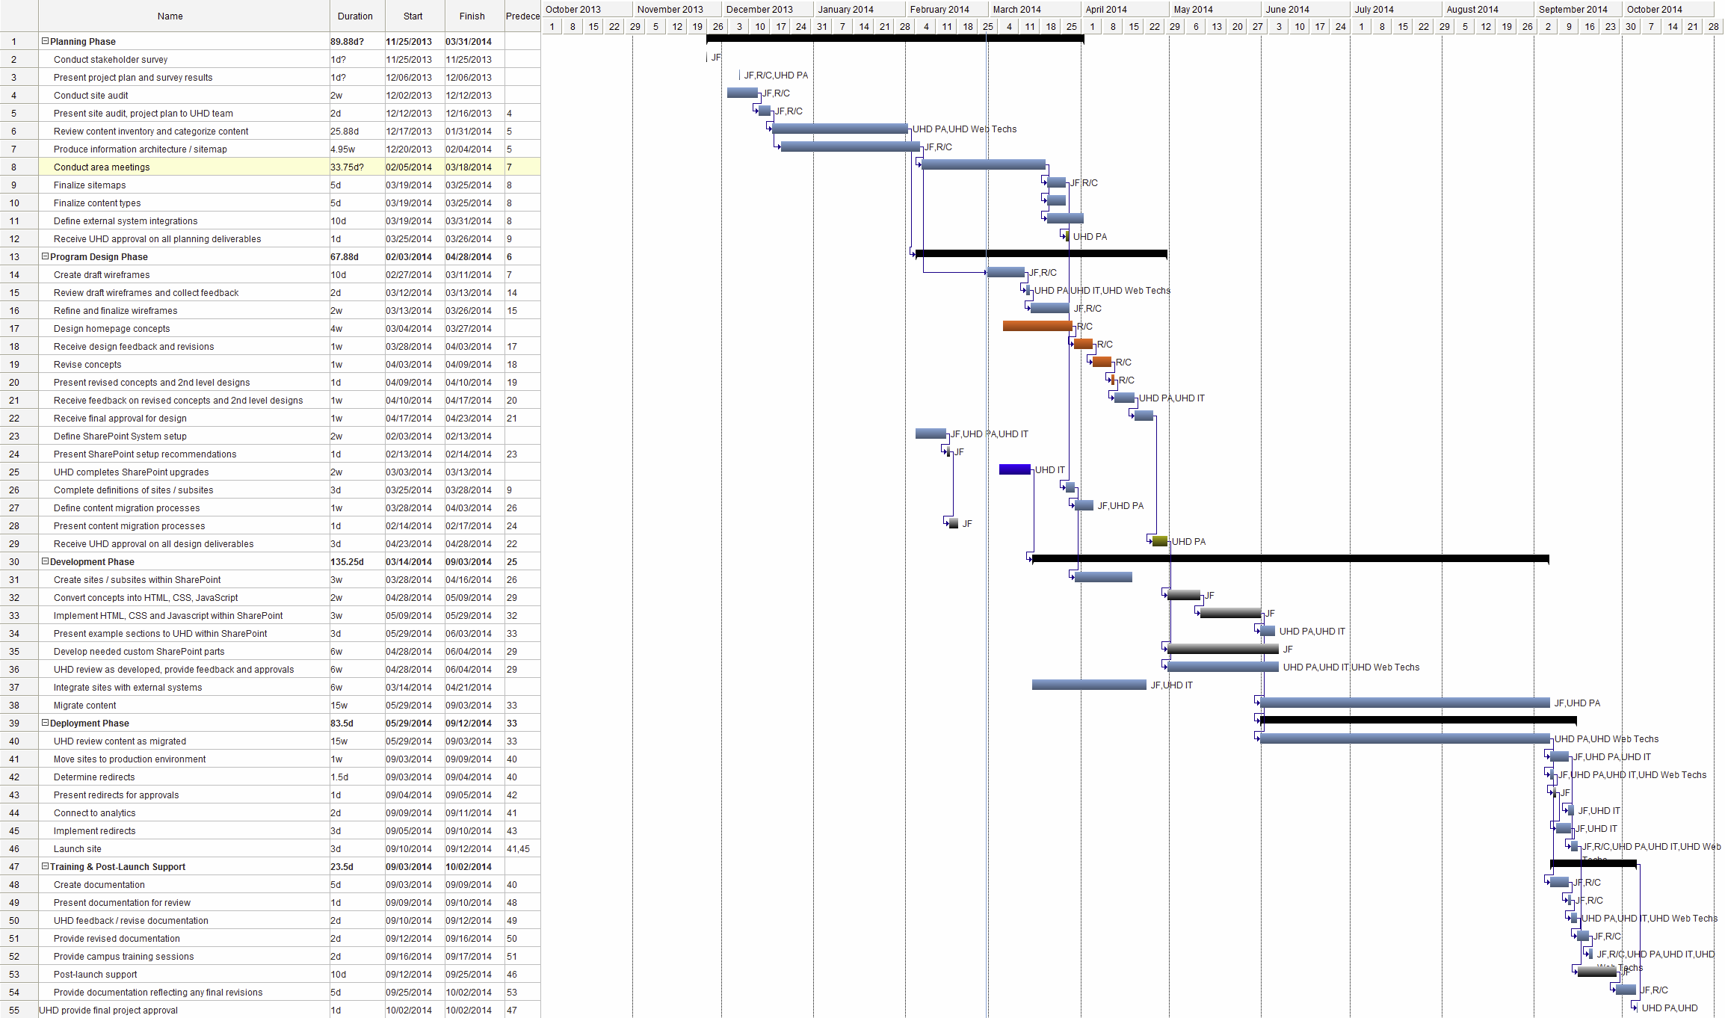
Website Redesign

Slide 18
Milestones
Review Content Jan 31
Site Maps Feb 14
Area Meetings (21) Feb 14 – Mar 18
Homepage – 1st draft Feb 28
Concepts Mar 26
Deployment Jun – Sept
Launch Sept 24
Training Sept – Oct

Slide 19
Web Update Meetings
Patricia Anderson
Lucy Bowen
Belinda Hernandez
Billy Hoya
Carlos Lacayo
Spencer Lightsy
Reubenjack Long
Josh Matranga
Lorenzo Morales
Jerry Nevarez
Cherilyn Pearson
Chris Reynolds
Hossein Shahrokhi
Patricia Strohl
Duong Tran
Monica Villarreal
Marc Williams
Joe Wynne

Slide 20
Thank you!

