Slide 1
University of Houston-Downtown
Welcome Center/Girard 3/Garage Update
Presented to the UHD Faculty Senate
February 18, 2014

Slide 2
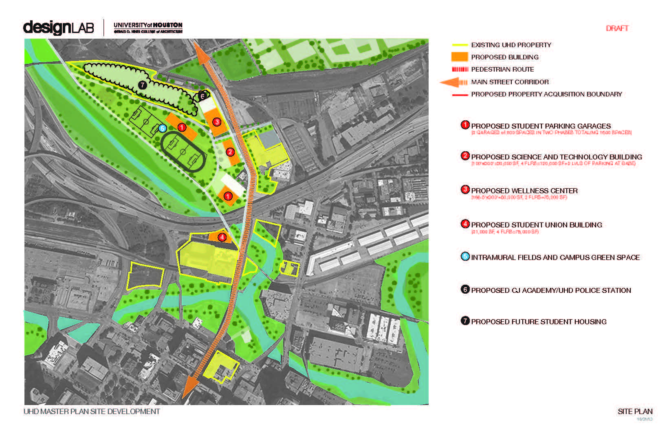

Slide 3
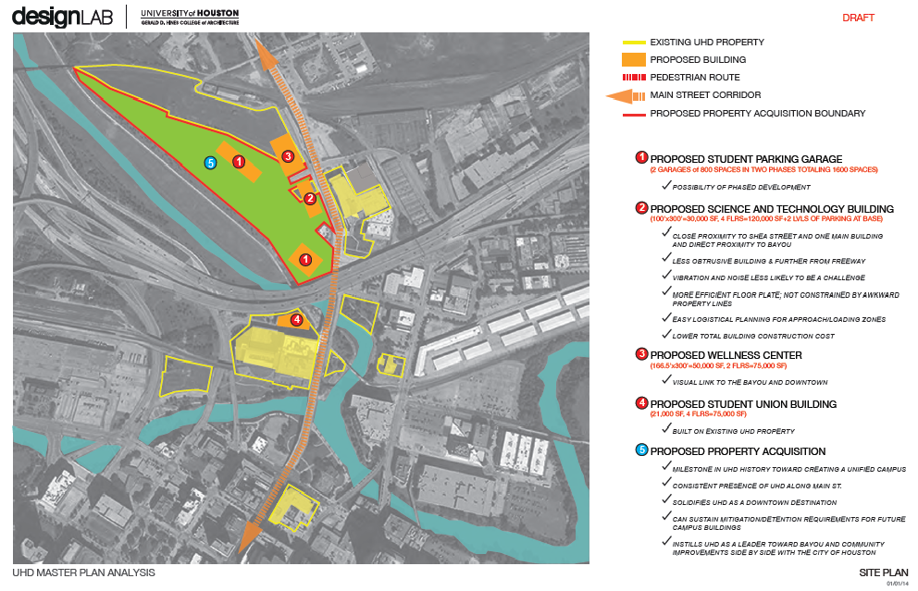

Slide 4
Original Plan
Board Approved – May 2013
Welcome Center
Girard 3 – fully built out
  Aligns with the 3rd floor plate of OMB and AB
  Admissions, Testing, Veteran’s Services, Disability Services, O’Kane Gallery
Girard Garage
  Four levels of parking – 367 total spaces, incl. 88 for visitor/disabled
Projected Cost: $16.5 million
Projected Completion
  Garage (August 2014)
  Other (November 2014)

Slide 5
Revised Plan
Resubmit to Board – Feb 2014
Welcome Center – mostly unchanged
Girard 3 – 100% shelled out (reduces cost by $1.4M)
  University will fund built-out of the same functions, but as Phase II with HEAF
Girard Garage
  Three levels of parking – 257 total spaces, including 70 for visitors/disabled (reduces cost by $2M)
Projected Cost: $19 million (reductions shown above plus $1.3 million of additional savings)
Projected Completion: All (March 2015)

Slide 6
Parking Space Counts
Fall 2011 – Spring 2015
 | Fall 2011 | Spring 2012 | Fall 2013 | Spring 2015
OMB Fac/Stf (incl’ buddy) | 359 | 359 | 0
OMB Disabled | 17 | 17 | 0
Gold Fac/Stf | 32 | 32 | 0
Academic Building Fac/Stf |  | 112 | 112 | 162
Academic Building Disabled |  |  | 17
Girard Street Garage Fac/Stf |  |  |  | 187
Total Faculty/Staff Parking | 408 | 520 | 129 | 349
 | Fall 2011 | Spring 2012 | Fall 2013 | Spring 2015
Visitors – Academic or Girard | 50 | 50 | 23 | 70

Slide 7
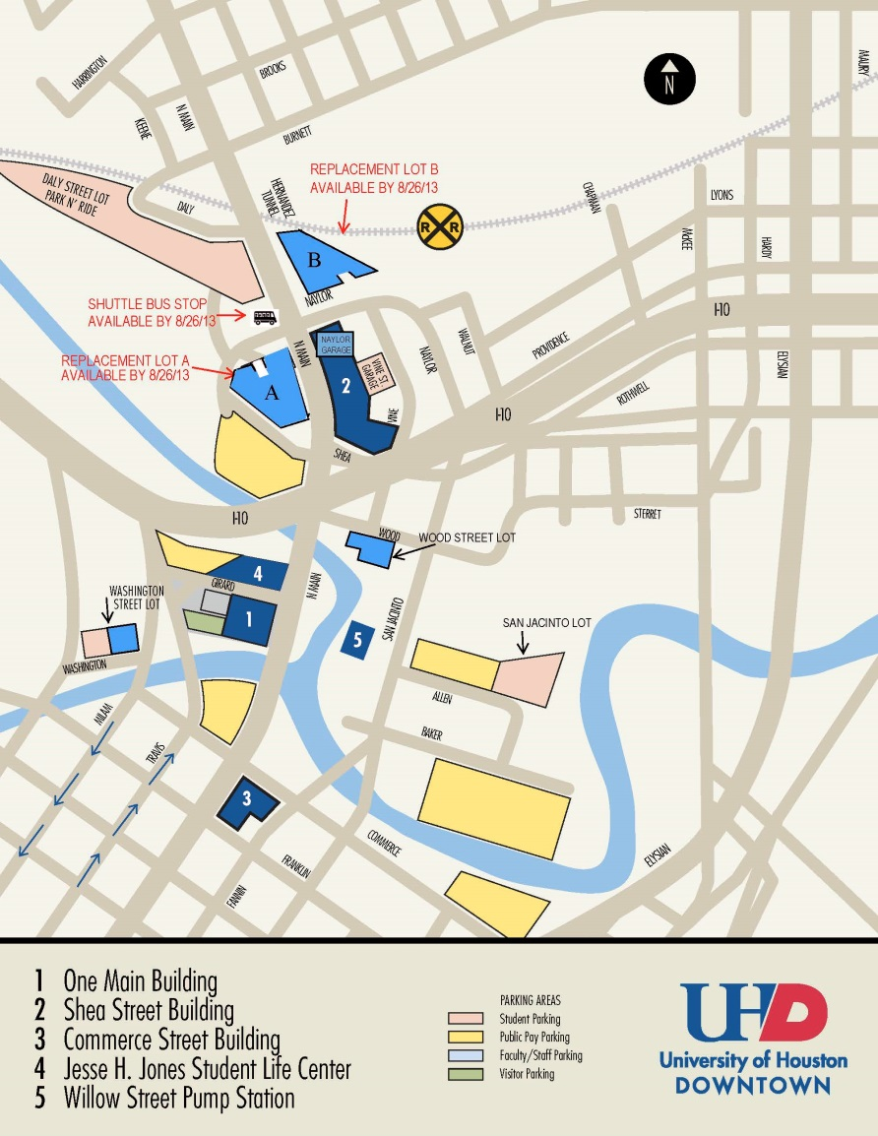
UHD CAMPUS PARKING MAP

Slide 8
For consideration
Consequences of reduced parking in the Girard Garage
While not ideal, impact may not be as severe as anticipated
Capacity lost since demolition of the OMB Garage has been absorbed by Replacement Lot A and Naylor Garage
Replacement Lot B was so lightly used by Fac/Stf it was made available to students
Replacement Lot A has 177 spaces
Girard Garage, net of Visitors spaces, will provide 187 spaces
An additional 50 Fac/Stf spaces will come from current Academic P1

Slide 9
How to explain reduced demand
Some demand for OMB Fac/Stf was questionable
  Exceptions (too many?) were made for temp and student workers
  People would drive from other buildings to attend meetings in OMB
Surging growth in instructional modes that do not require physical presence
  On-line and hybrid courses
  Am told now that this has minimal impact on faculty need to be on-campus
Behavioral changes
  Some faculty/staff choosing public pay lots?
  More car-pooling/ride-sharing as parking has become more scarce?
  Increased use of expanded public transit options (LRT)?

Slide 10
Other Considerations
Anticipated challenges
The obvious – less in-close parking than we’d prefer
Allocation of spaces must be handled fairly
  Faculty will suffer most if ‘first-come, first-served’ model is adopted
  Parking & Transportation Committee will explore options
  Could continue with the lottery system until relief comes
What will relief look like?
  Additional buildings – Science & Technology, Wellness Center, Student Union
    All would include some parking, which would pull people out of the Girard Garage
  Additional structured parking
    Next garage will be for students but could include a section for faculty/staff

Slide 11
...on a positive note
Traffic congestion on Girard has always argued for a smaller Girard Garage
  This was a request from the Police Chief early in the process (overruled)
  Already have pick-up/drop-off, metered lot, Police Dept., loading dock traffic on Girard
With Visitor parking on P-1 rather than P-Zero it will be easier to expand Visitors in the future (after more Fac/Stf parking is developed elsewhere)

Slide 12
The Long View ...
In-close parking, while nice, can’t drive the decision
Girard 3 on the same floor plate as OMB 3 and Academic 3 is important
The money not spent on this project can be put toward land acquisition
Walking a short distance from a garage or surface parking lot to a building is the norm in many places

Slide 13
Questions/Comments?

