Slide 1
US Bank Access Online Registration Guide

Slide 2
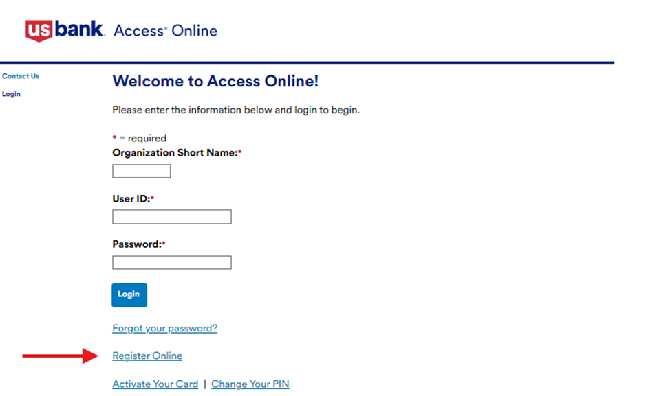
Begin Registration
Navigate to US Bank Access Online (www.access.usbank.com)
Select Register Online

Slide 3
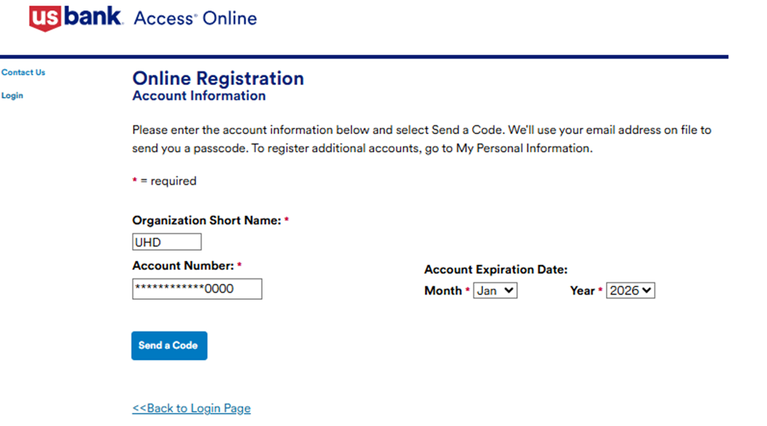
Enter Card Information
Enter the following information
  Organization Short Name = UHD
  Account Number = 16-digit p-card number
  Account Expiration Date = P-Card expiration date
Select Send a Code

Slide 4
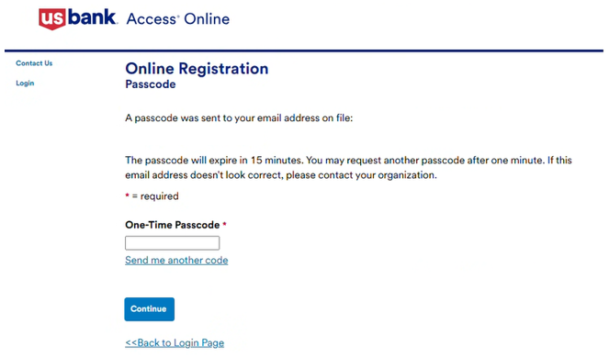
Online Registration Passcode
A passcode will be sent to your UHD email address
Once received, enter the one-time passcode and then select Continue

Slide 5
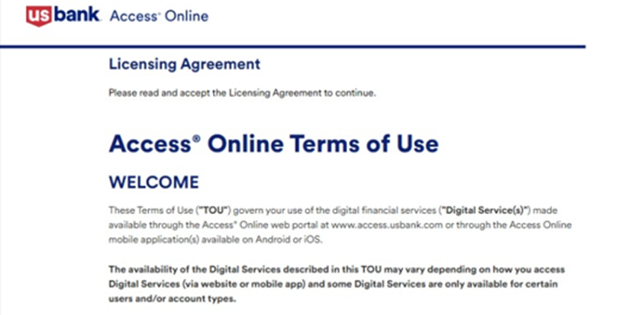

Terms of Use
Review the Access Online Terms of Use and select I Accept

Slide 6
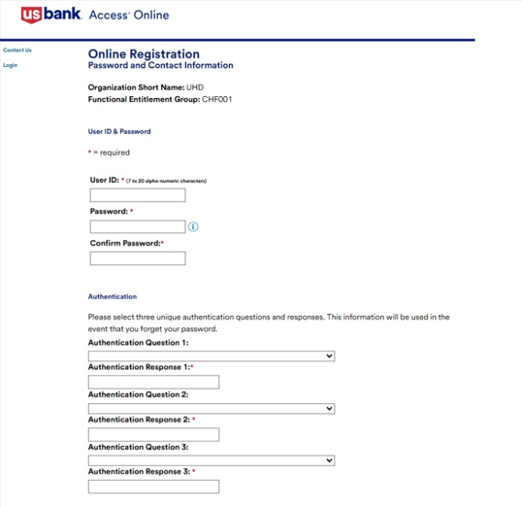
Enter Account Information
Enter User ID
  First initial and last name, with the first two letters in CAPS, followed by a two-digit number of your choice (you may add more numbers if needed to meet the 7-character requirement).
  Example: EPaige2026
Create your own password and enter it twice
Specify your three authentication questions and answers

Slide 7
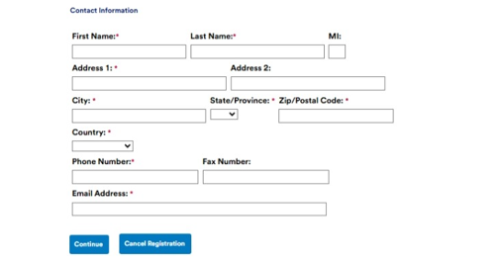
Enter Account Information (cont.)
Enter the following contact information:
  First Name
  Last Name
  Address 1 = One Main Street
  City = Houston
  State/Province = TX
  Zip/Postal Code = 77002
  County = USA
  Phone Number
  Email Address = your uhd.edu
Select Continue

Slide 8
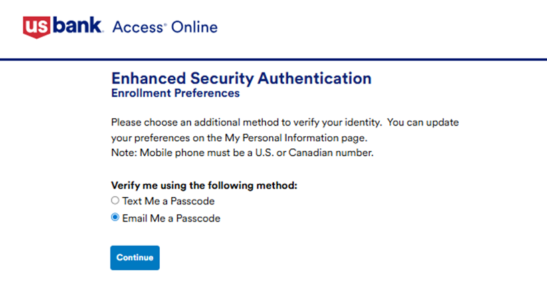
Enhanced Security Authentication
Select Email Me a Passcode, then the Continue button

Slide 9
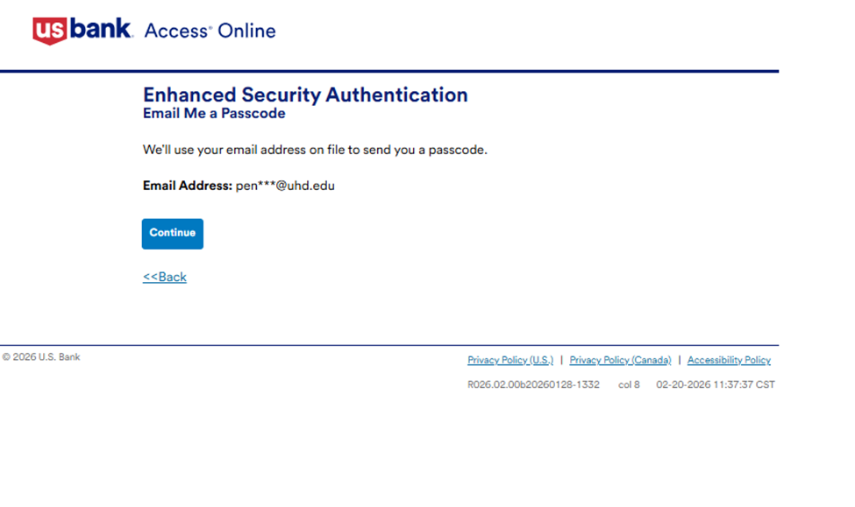
Enhanced Security Authentication (cont.)
Select Continue to receive the Enhanced Security Authentication passcode

Slide 10
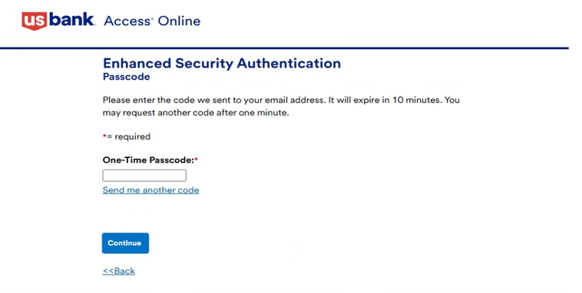
Enhanced Security Authentication (cont.)
Once received, enter the one-time passcode and then select Continue

Slide 11
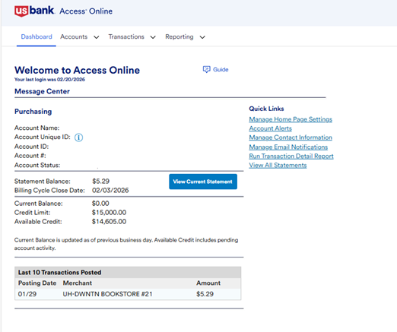
Dashboard
You will now have access to the US Bank Access Online Dashboard

