Slide 1
US Bank Access Online
Processor Guide

Slide 2
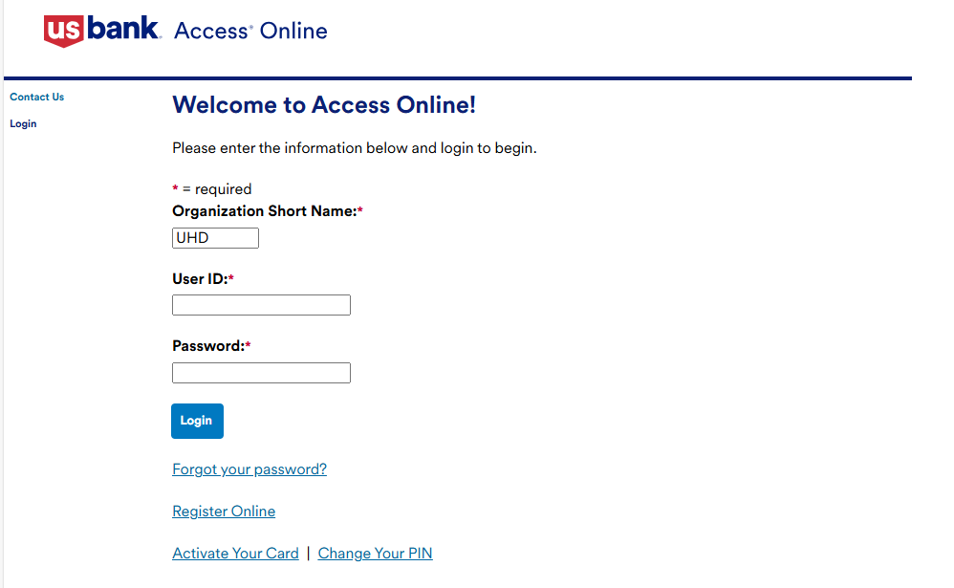
Login
Organization Short Name: UHD
User ID: First name initial + Last Name + 2 or more numbers (ex. EPaige01)
Enter password
Click the Login button

Slide 3
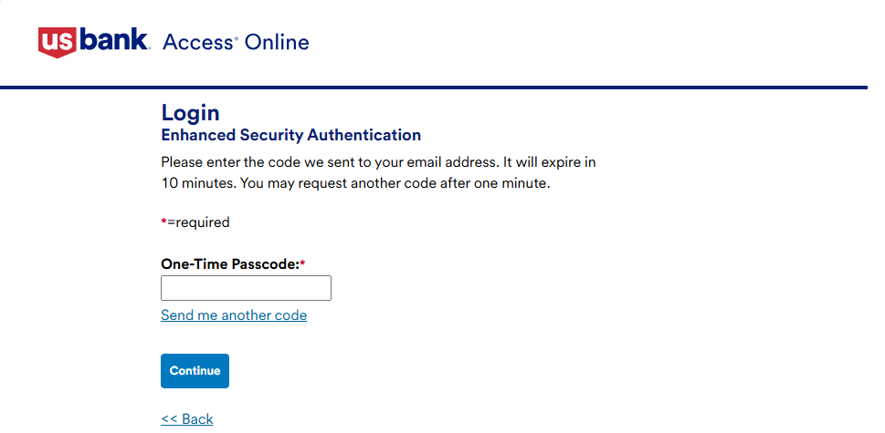
Login (cont.)
One-Time Passcode will be sent via email
Once received, enter the passcode and then select Continue

Slide 4
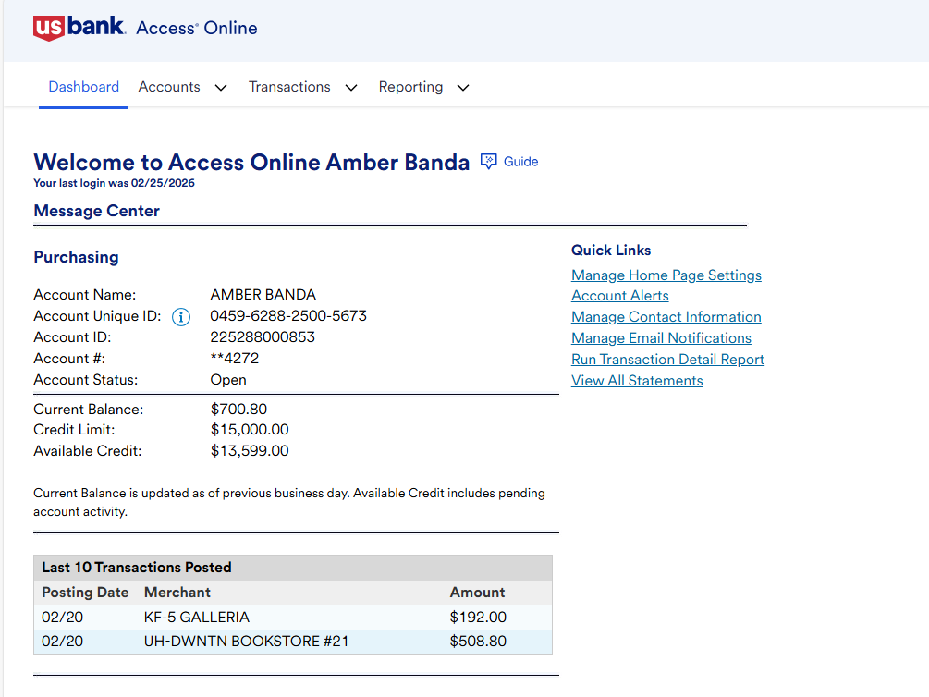
Dashboard
The dashboard contains important account information
  Account Number
  Current Balance
  Credit Limit
  Available Credit
  Last 10 Transactions

Slide 5
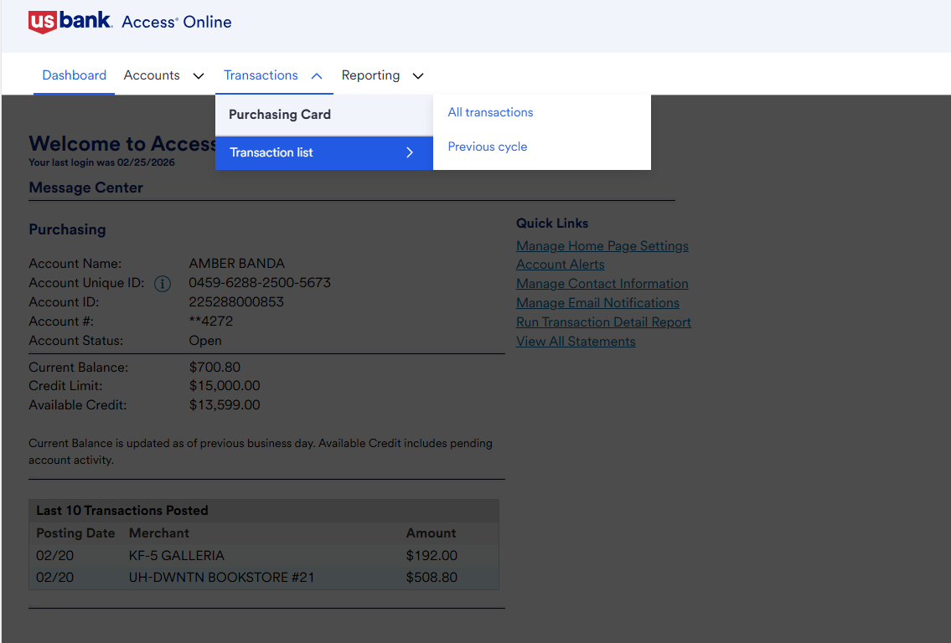

View Transactions
Navigation: Open the Transactions menu and then select All transactions

Slide 6
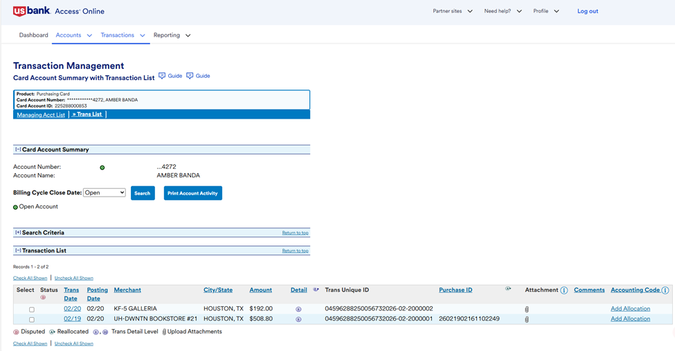
View Transactions (cont.)
Posted transactions can be viewed under the Transaction List section
Click the link under the Trans Date column for the transaction you would like to view

Slide 7
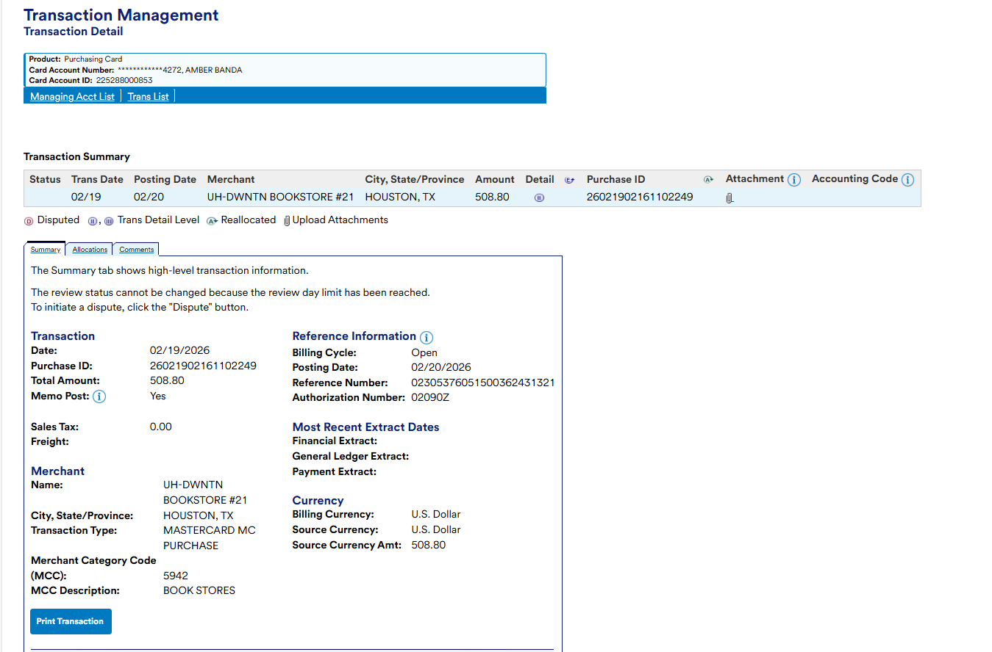
Transaction Summary
You will be taken to the transaction summary
The transaction summary displays detailed information of the transaction

Slide 8
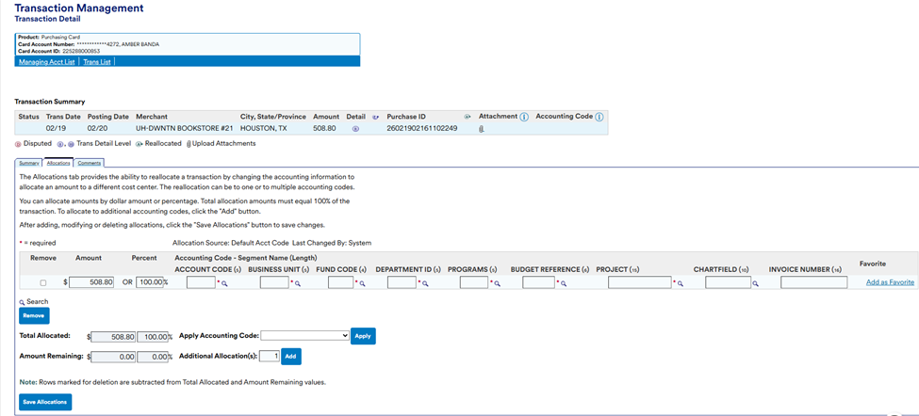

Transaction Allocation
Select the Allocations tab
Enter the account and cost center information. Once completed, select Save Allocations

Slide 9
Split Transactions
If you would like to split a transaction, enter the number of Additional Allocation(s) in the respective field (ex. For a transaction that needs to be split two ways, enter a 1 in the field) and click the Add button.

Slide 10
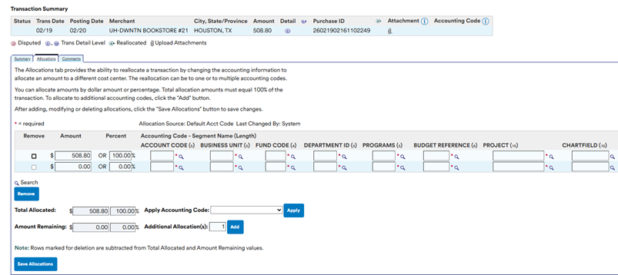
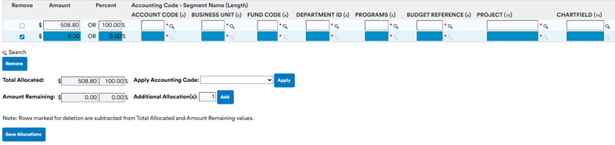
Split Transactions (cont.)
Another allocation line should appear. Enter the necessary information in the new fields and click the Save Allocations button
Splits can be removed by selecting the “Remove” checkbox on the left side of the transaction and clicking the Remove button

Slide 11
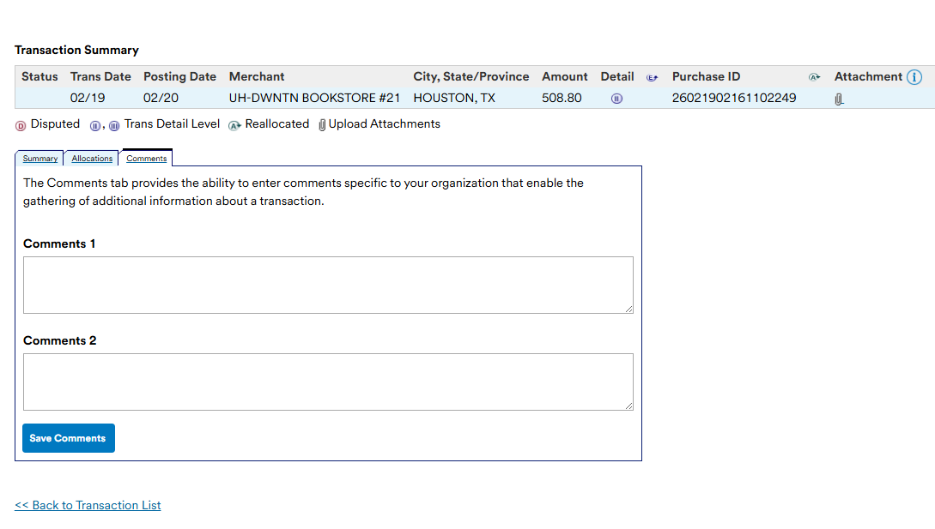
Add Purpose/Benefit Statement
Select the Comments tab and enter purpose and benefit statement in the field. Once completed, select Save Comments.
*NOTE* P/B STATEMENT MUST BE LESS THAN 250 CHARACTERS
Click the Back to Transaction List link to return to the transaction list.
Repeat this process with any remaining transactions.

Slide 12
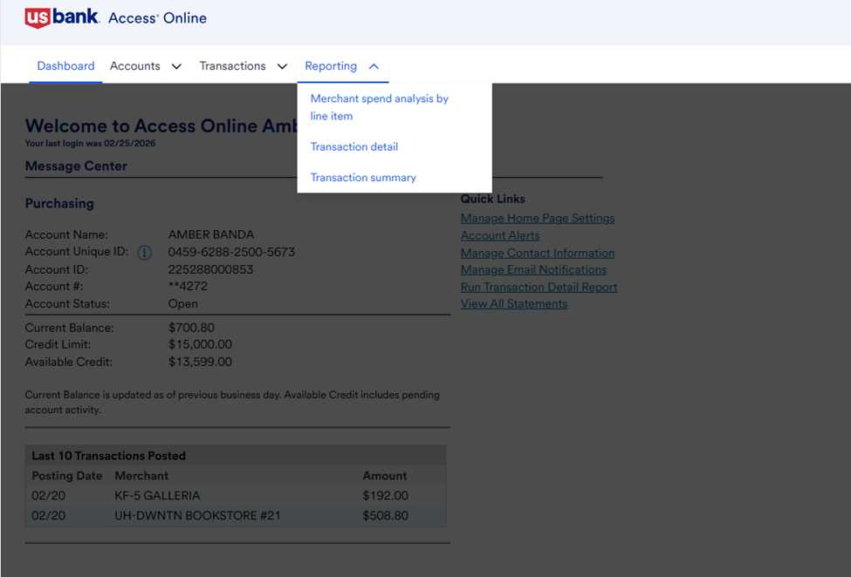
Run Report
Navigation: Open the Reporting menu and select Transaction Detail

Slide 13
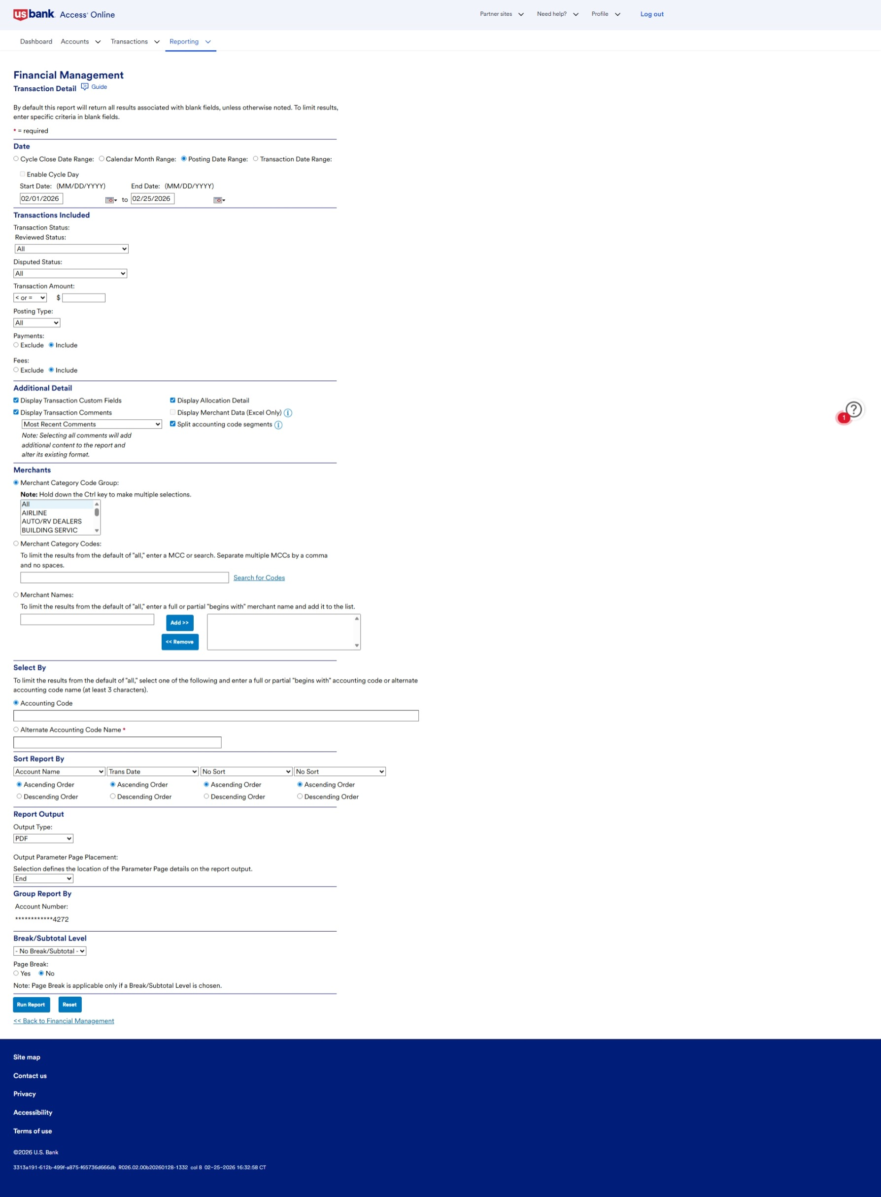
Run Report (cont.)
Ensure to select the criteria for the following sections:
Date: Select Posting Date Range and enter the correct start/end dates
Transactions Included: Select the Include button for both payments and fees
Additional Detail: select the following: Display Transaction Custom Fields, Display Allocation Detail, Display Transaction Comments (ensure the dropdown is on Most Recent Comments), and Split account code segments

Slide 14
Run Report (cont.)
Skip the Merchants, Select By, and Sort Report By sections
Report Output: Ensure to select PDF as the Output Type
Group Report By: Ensure the correct account number is listed
Skip Break/Subtotal Level
Review your report settings and click the Run Report button. Ensure to allow pop-ups on your web browser. The Report will open as a PDF in a separate window

Slide 15
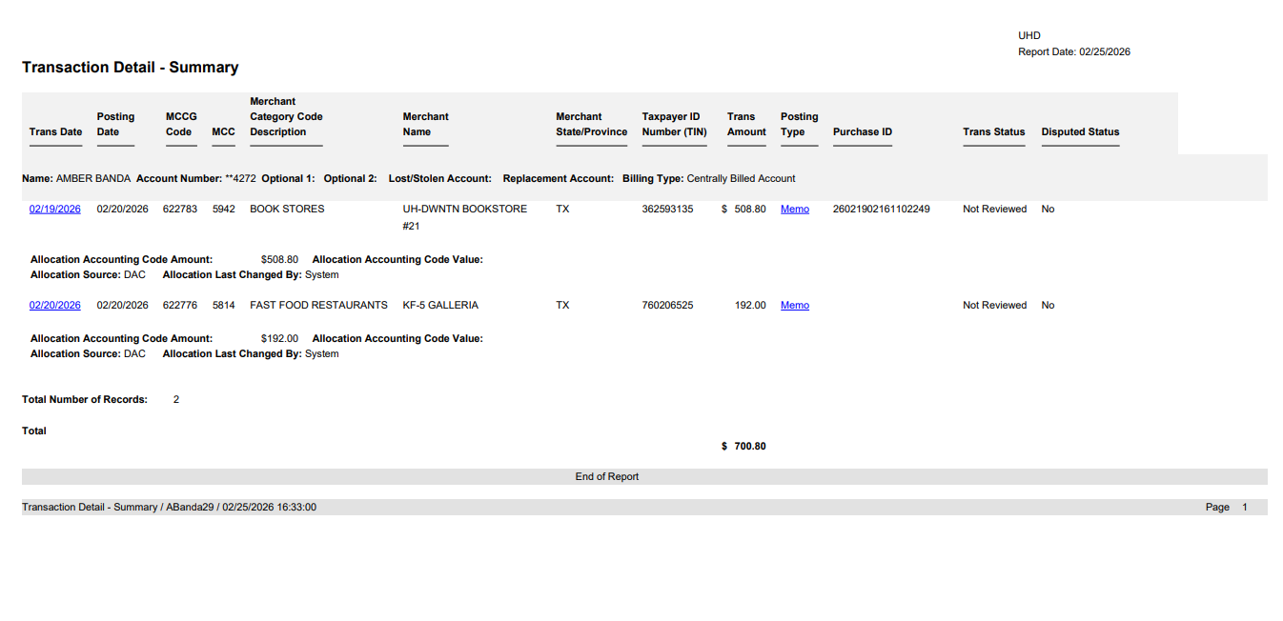
Sample Report
The report will open instantly in a new window
If ran correctly, this is how the report should look -->

