Slide 1

Completing Your Continuity Plan (COOP)

Slide 2
COOP Planning Steps
Have a designated Continuity Planning Liaison​
1
Schedule a Department/College Continuity Planning Meeting to obtain information and to develop contingency procedures​
2
Fill out or update the template ​
3
Submit the template to your Department/College leadership for review and approval​
4
5. Submit the approved template to UHD Emergency Management
5

Slide 3

Continuity Planning (COOP) Support
UHD Emergency Management offers consulting to assist your department in completing, reviewing, and exercising your continuity plan. Contact the COOP Program Coordinator, Tabbitha Ross, uhdemergencymanagement@uhd.edu for assistance.

Slide 4
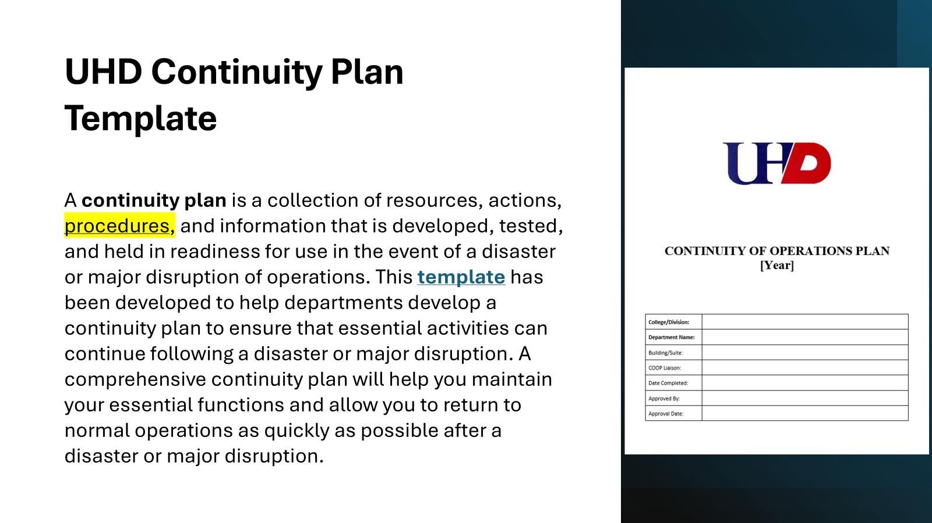
UHD Continuity Plan Template

Slide 5
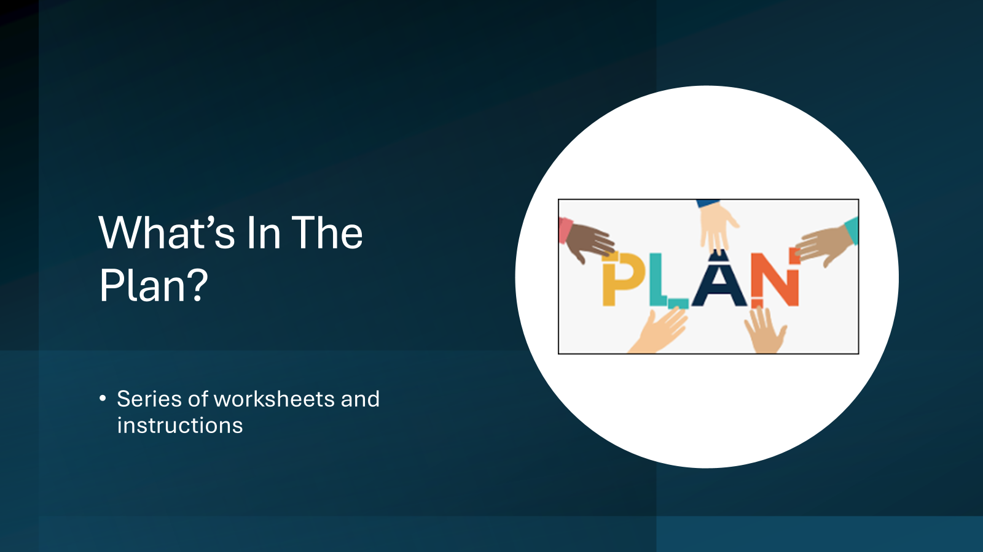

Slide 6
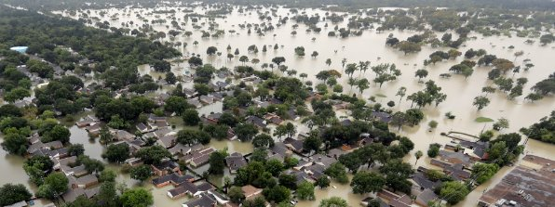
Planning Scenarios
UHD uses three primary scenarios that reflect the type of events which could result in a continuity plan activation. The planning scenarios are not necessarily mutually exclusive. Multiple scenarios may occur within one incident. For example, an incident may result in a loss of access to the facility as well as IT or data loss.
Planning Scenario 1 – Single or Multiple Facilities/Buildings Affected
Planning Scenario 2 – Loss of Personnel
Planning Scenario 3 – Loss of IT or Data

Slide 7
Introduction - Implementation Plan
The Implementation Plan provides general guidance on implementing your continuity plan following a disruption. The steps included can be followed by anyone within the organization charged with implementing the plan. Additional steps can be added as needed based on the specific needs of your department/college. During a disruptive event, your department/college will implement this plan based on the general strategy below:
Notify key personnel of plan activation
Establish staff accountability – following emergency incident
Resume essential functions based on department/college priority rating
Communicate with internal and external stakeholders
Conduct damage assessments, as needed
Report damage up through leadership chain to PD or FM
Review available internal space within your division/college/department
Report facility requirements up through division or college if your division or college internal space is not available or adequate
Relocate staff to alternate space
Resume normal activities as appropriate and communicate to stakeholders and leadership

Slide 8
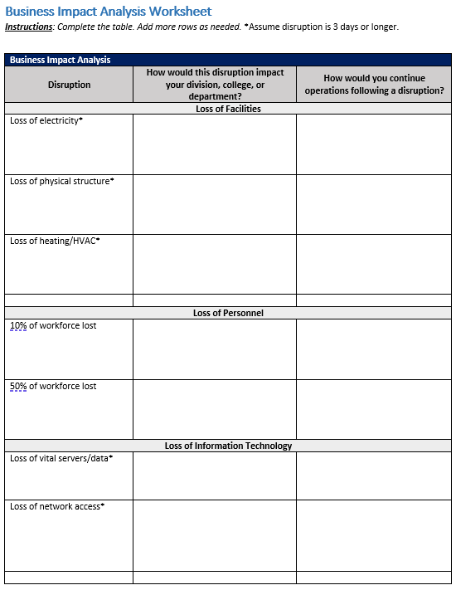
Business Impact Analysis
Describe how or whether the disruption would adversely affect your operations.
What recovery or mitigation strategy could you use to continue your operations?

Slide 9
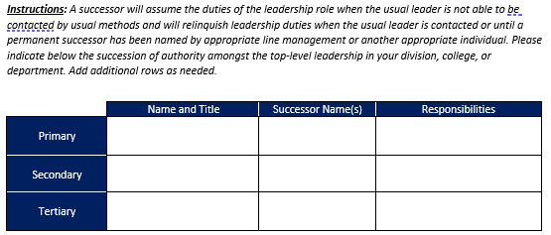
Leadership Succession (Chain of Command)
Succession planning enables an orderly and predefined transition of leadership when leadership becomes absent.
Succession planning helps to ensure that necessary talent and skills will be available when needed, and that essential knowledge and abilities will be maintained when leadership in critical positions become unavailable.
They act as a sound risk management practice that ensures the viability of an agency during disruptive events.

Slide 10
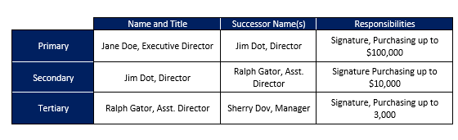
Completed Leadership Succession

Slide 11
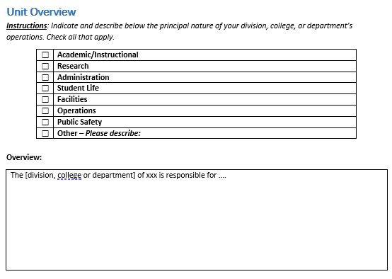
Unit Overview
This section helps departments focus on the core nature of their operations and identify their essential functions. Please indicate and describe below the principal nature of your department's operations on the Unit Overview worksheet. The overview section should be filled with your department or unit's mission statement or with a brief description of your department's operations.

Slide 12
Essential Function Worksheet
Essential functions are those services, programs, or activities that are necessary to the operations and would directly affect the university’s success if they were to stop for an extended period.
Your essential functions will serve as your guide for how to restart your operations following a disaster or major disruption. They help answer the question: "What is the minimum level of service or activity my department must offer to remain operational?“
By identifying and prioritizing your essential functions, you can determine which personnel, facilities, equipment, and materials are absolutely necessary to keep your department functioning following a disaster or major disruption.
The success of your department and the support you provide to the University rely on these functions. Stopping them for an extended period of time would cause an unacceptable disruption to your operations and possibly other departments' as well.

Slide 13

What are Recovery Time Objectives?
A recovery time objective (RTO) is the maximum time a function can be down before it must be resumed. The RTO is the answer to the question: "what is the maximum time a function can be down before it must be resumed?".
Another way to think about the RTO is the answer to the question: "What is the maximum time a function can be down before it must be resumed?"
RTOs help us organize our essential functions into the following categories: Critical, High, Medium, Low, Deferrable. We can prioritize our essential functions based on their RTOs:
Critical – must be restored within 4 hours
High- Pausing for more than 24 hours may cause significant consequences of serious harm
Medium – Stopping for more than one week may cause major disruptions. Must continue, perhaps in a reduced mode
Low – May be suspended for up to one month without causing significant disruption
Deferrable – May pause until conditions permit

Slide 14
Determining and prioritizing your department’s essential functions
One way to determine your essential functions is to look at your department's organizational structure. This should help you identify the general functions that your department performs.
While everything you do each day may seem important, some functions and activities are more essential than others. Some activities can be suspended for several weeks, while others cannot stop for more than a few hours. Prioritizing your functions will help you establish a recovery plan that focuses on the functions that are the most important.
You should be able to organize your operations into 4 to 6 essential functions. This number may increase or decrease depending on the complexity of your department or unit. If your list of functions is long, consider grouping similar activities into a single function.
A function may be essential if:
There are a limited number of employees available who could perform the function or job duty; and/or ;
The position was created for the purpose of performing the function or job duty;
The function or job duty is highly specialized, and the position requires a special expertise or ability to perform the job duty.

Slide 15
Activity - Determining Essential Functions
The following activity can help your team and relevant stakeholders determine essential functions for your department:
As a team, list the functions your department performs. Note: functions are what your department does while processes are how your department accomplishes that function. For example, "special event planning" would be a function and "going to meetings" is part of the process.
Assign a recovery time objective to each of the functions identified. Remember, the recovery time objective is the maximum time a function can be down before it must be resumed.
Separate and organize all your functions into the critical, high, medium, low, and deferrable categories based on the recovery time objectives.
Congratulations! Your department has determined and organized its essential functions. We recommend completing essential function worksheets as a team for those functions in the critical, high, and medium categories. Add additional worksheets for functions in the low and deferrable categories as appropriate.

Slide 16
Examples of Essential Functions
Academic Departments
Conduct Classes (High)
Academic Records/Transcripts (Medium)
Academic Advising (Low)
Student Support Services (High)
Administrative and Leadership Support (Medium)
Study Abroad (High)
Operational Departments
Payroll (Medium)
Purchasing (High)
Workers Compensation Services (Medium)
Research Departments
Preserve Specimens and Data (High)
Conduct Research (Medium)
Grant Administration (Low)

Slide 17
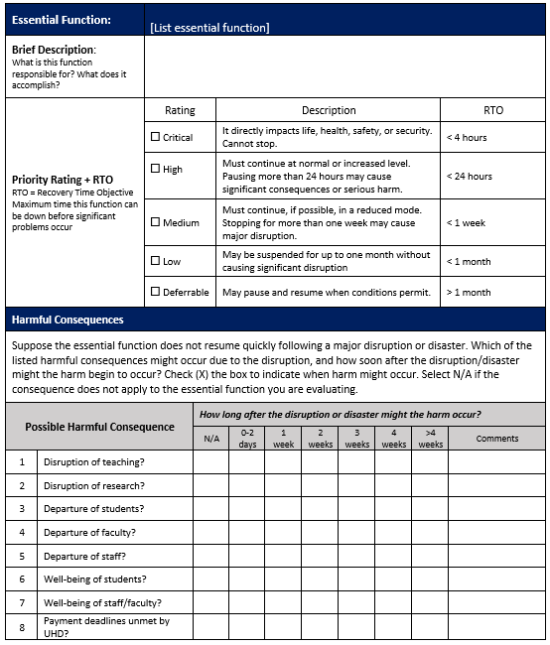
Essential Function Worksheet
The Essential Function Worksheet contains information to help your department carry out essential operations following a disaster or emergency.
Each departmental template includes 3 essential function worksheets (add more as needed). We recommend using these worksheets to document essential functions with a critical, high, or medium category. Add low or deferrable essential functions into worksheets as appropriate.

Slide 18
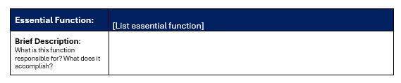
General Information
Indicate your group's name, the essential function being detailed in the worksheet, and a brief description of the function in this section.

Slide 19
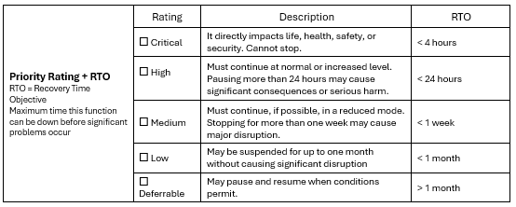
Essential Function Category & Recovery Time Objective (RTO)
Check one box with the Rating corresponding with the essential function. Remember: the recovery time objective (RTO) is the maximum time a function can be down before it must be resumed.

Slide 20
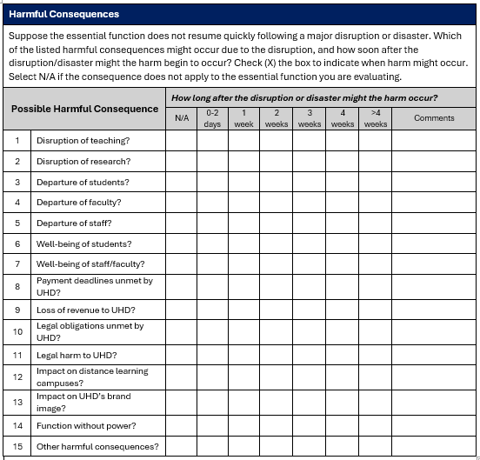
Harmful Consequences
How long after the disruption will harm occur?

Slide 21
Emergency Access to Information and Systems
Consider the Following Scenarios:
A disaster causes physical damage to computers and drives containing valuable files and information
Your department's information is compromised by a cyberattack
A power failure causes hardware damage and data loss on many computers
Continuity Planning Considerations:
Maintain a list of vital documents, drives, and folders and where they are backed up
Ensure that automatic back-up is scheduled and performed on all network computers
Keep duplicate copies of important documents stored in a secure off-site location or on an encrypted USB storage device.

Slide 22

Internal Dependencies vs External Dependencies
Internal Dependencies
Products and Services provided by other UHD units. Examples:
Risk Management provides support and information related to insurance needs.
External Dependencies
Products and Services provided by non-UHD entities.
Reliance on Chartwells to provide food on campus.

Slide 23
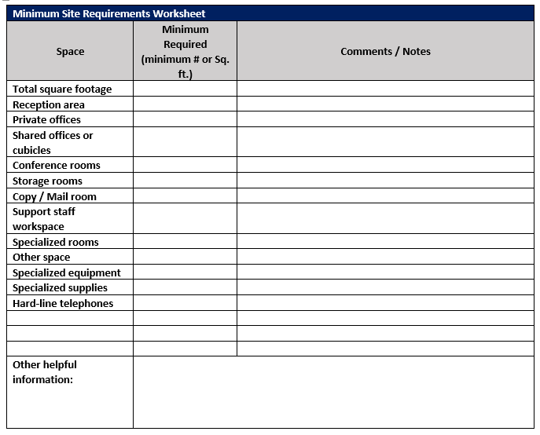
Alternate Site Worksheet
A disaster, whether large or small, may force you to relocate your operations for an extended period of time. A fire, flood, chemical spill, sprinkler malfunction, or even smoke from a fire in another office are just some of the incidents that may require you to relocate. Total recovery and restoration may take several days to several months. If your unit was relocated to a different building or suite, what space needs do you have?
Having those site requirements prepared beforehand will help expedite the process of obtaining an alternate space in case of a disaster.

Slide 24
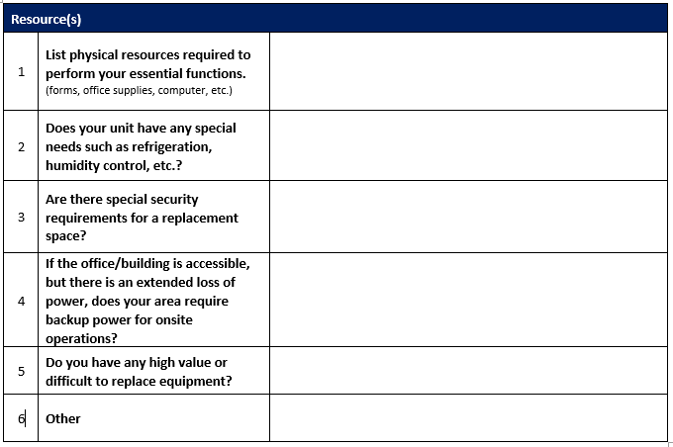
Resource Considerations
Describe other supply and equipment needs that you may have: how many docking stations, laptops, monitors, or computers will you need? Will you need landlines, printers, scanners or digital screens?
If you need require refrigeration, what size and how many appliances are needed?
Do you need cubicles? How many and what type?

Slide 25
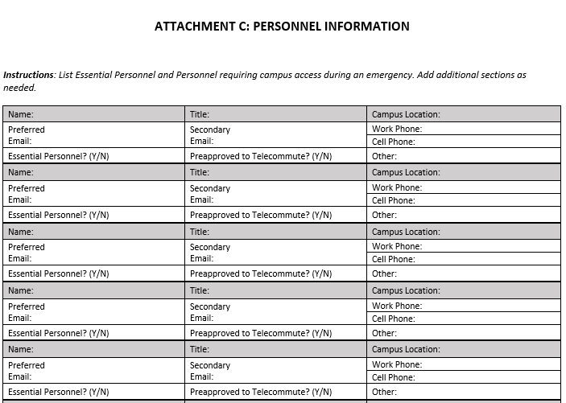
Personnel
List Essential Personnel and persons needing campus access during emergencies and during campus closures. At times, researchers, campus leaders, or employees performing specialized functions may need access to campus. During university closures, personnel must check-in at the UHD Police Department to enter campus. List these persons on Attachment C.

Slide 26
Emergency Communications
Following an emergency, UHD will publish general information via text, email, social media, and the UHD web page. However, every division, college, and department needs to ensure they can communicate with their own employees. In addition to accounting for employee wellbeing, there may be specific work-related procedures that need to be implemented or changed.

Slide 27
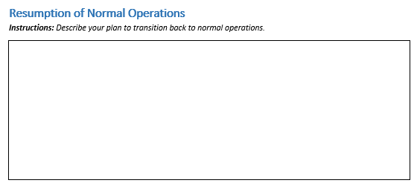
Resumption to Normal Operations
Once the disaster has ended and you can reoccupy your suites or building, how will you transition back to campus? Will you need a phased approach for your division, college, or department?

Slide 28

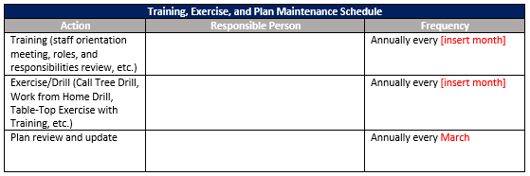
Training, Exercise, and Continuity Plan Maintenance
A continuity plan must be reviewed and tested in order to be effective. All employees of your department should be familiar with the continuity plan to help ensure that your department continues operations following a disaster or major disruption. The template includes a schedule to help your area train, exercise, and maintain its continuity plan.
Instructions: Create a schedule for your area to train and exercise this continuity plan.

Slide 29
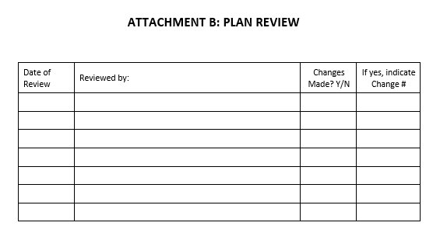
Annual Plan Review
Your area's continuity plan should be reviewed annually by someone in your division, college or department. The review process should ensure that information and contacts in the plan are up to date. If significant changes are made that would influence how the University, your or other departments within the University would conduct continuity operations, the new version of your area’s COOP should be submitted to the UHD Continuity Coordinator (uhdemergencymanagement@uhd.edu) within 30 days of the change.

Slide 30
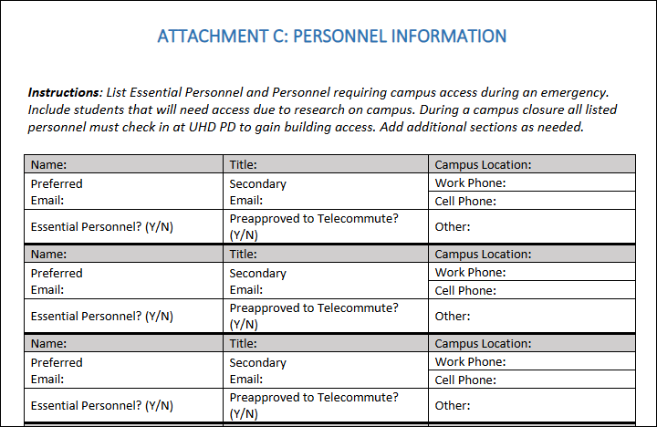
Attachment C: Personnel Information

Slide 31
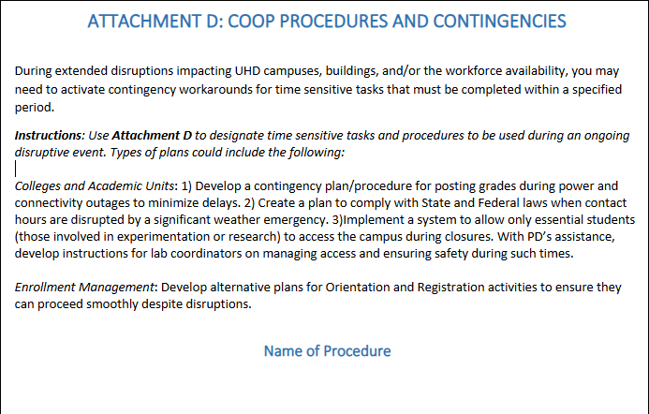
Attachment D: COOP Procedures
As your area develops contingency procedures, add them to this section. Add as many as you need. This section serves as your COOP playbook.

Slide 32

Submitting Your COOP
Give yourself a minimum of one month to review and update your plan.
Once the COOP Liaison has updated the plan, have your plan reviewed and approved by your division, college or department Head. Upon their approval, submit a copy of your plan to the UHD Continuity Coordinator at (uhdemergencymanagement@uhd.edu) by April 1 of each year.
Maintain a copy in your department and share your plan with your division, college, and department leaders.

Slide 33
Questions
Cynthia Vargas - Director of Emergency Management x5848
Tabbitha Ross - COOP Coordinator x2783
uhdemergencymanagement@uhd.edu

