Slide 1

Budget Office
Endowments
June 2014

Slide 2
Participants Understanding Of:
Endowment Definition
Types of Endowment Funds
Terms and Definitions
Income Cost Center Funds
Minimum Funding Levels for Endowments
Endowment Establishment
Recommended UHD Spending Policy
Roles and Responsibilities
  Budget Office
  General Accounting
  Financial Aid Office
  Department Heads/Deans/Business Administrators
Jointly Accountable and Responsible
  PeopleSoft Navigation - Endowment Agreements

Slide 3
What is an Endowment?
Endowment = Donation, Gift, Bequest (Inheritance)
Endowments provide ongoing benefits for those that receive them by earning a market rate of interest while keeping the core endowment principal intact to fund future years of scholarships, or whatever efforts the donor sought to fund

Slide 4
Types of Endowments
True Endowment
Principal amount can never be spent, but investment income should be expended
Term Endowment
Principal may be spent on or after a predetermined date or period of time or the occurrence of a specified event
Quasi Endowment
Established by the university using university funds, treated as an endowment but not subject to any legal prohibitions against spending, or dissolving the endowment

Slide 5
Terms and Definitions
Endowment Agreement
The written document, including a university’s solicitation, under which property (cash, real estate, etc.) is donated or granted to the university and held as an endowment
Distributable Income
The portion of income available for expenditure according to the purpose of the endowment
Income
Interest, dividend income, realized gains and royalties received from the principal of the endowment

Slide 6
Terms and Definitions
Corpus (Historic Dollar Value)
The aggregate amount of all contributions by a donor or donors to an endowment. This is not the same as book value.
Book Value (Carrying Value; Fund Balance)
The original cost basis of an endowment, plus adjustments for gains or losses, additional gifts, external management fees and any other transfers to or from the fund
Above Water
A term used to describe an endowment whose current market value is more than its corpus
Under Water
A term used to describe an endowment whose current market value is less than its corpus

Slide 7
Income Cost Center Funds
2076 – Designated Endowment Income
4028 – Restricted Scholarship - Endowment Income
4042 - Restricted General – Endowment Income

Slide 8
Minimum Funding Levels
Chairs | $500,000
Professorships | $250,000
Other Academic Appointments | $100,000 - $250,000
Graduate Student Fellowships | $50,000
All Others | $10,000
Minimum funding of $10,000 is needed to establish an endowment
Funds can be collected into a gift cost center until a minimum of $10,000 is reached

Slide 9
Endowment Establishment
University Advancement initiates solicitation
All endowment establishment originates at UA
Standard System Endowment Agreement for True and Term Endowments through University Advancement
Written Memorandum of Understanding (MoU) for Quasi-Endowments through University Advancement
General Accounting coordinates with the Budget Office to create an endowment cost center and corresponding income cost center respectively

Slide 10
Recommended UHD Spending Policy
Endowment department/college income cost center managers have full responsibility to utilize endowment income and not allow distributed income to accumulate excessively
Expend budgeted funds in accordance to the endowment terms
Endowment department/college income cost center managers to provide justification for excessive accumulation and details of future spending plan annually (details will follow in fall training concerning “excessive accumulation”)

Slide 11
Roles & Responsibilities – Budget Office
Establishes endowment cost center based on endowment agreement terms and conditions. Student Accounting establishes Banner detail code for scholarship cost centers and communicates with Financial Aid
Communicates and coordinates with UA on endowment cost centers on regular basis
Reviews departmental fund equity and budget balance available throughout the year and follows through with departments on outstanding items from review
Records all endowment related journal entries (Budget Office and General
Accounting)
Responsible for providing estimated endowment income to departments during
budget development cycle. The distributed endowment income is 4% of the
endowment’s average market value for the last three years. If this distribution
causes the endowment to be underwater the distribution will not occur.
Additional earnings are returned to the corpus so that the endowment will grow
over time.
Serves as liaison for department heads, business administrators on financial
information relating to UHD endowments and follow through on financial
issues of non-compliance

Slide 12
Roles & Responsibilities – General Accounting
Reconcile between UHD and UHS
Provide detailed financial information for donor report

Slide 13
Roles & Responsibilities – Financial Aid Office
Review and allocate institutional scholarship awards based on endowment terms and conditions (also known as criteria and/or restrictions)
Communicate and collaborate with department head/business administrator and University Advancement for any revisions to the original endowment agreement for institutional scholarships
Coordinate with business administrator to award college scholarships
Post and disburse awards (credit student account)

Slide 14
Roles & Responsibilities – Dept. Heads, Deans and Business Administrators
Responsible for ensuring available cost center balance is
expended in accordance with endowment terms/restrictions
Business administrators to meet and communicate with
department heads/deans the status of endowment
operating income cost centers
Ensure funds are expended per terms and conditions of the
endowment agreement. Otherwise provide justification and
spending plan to the Budget Office
Business administrators via the Provost Office to request
budget adjustments as needed for any additional budget or
amendment to the original budget

Slide 15
Roles & Responsibilities – Dept. Heads, Deans and Business Administrators
Via the Provost Office, communicate and collaborate with UA for any revisions to the original endowment agreement. UA will coordinate all revisions via MoUs and the creation of new endowment agreements via UH System
Communicate as requested by UA how the funds are being used generally and specifically highlight specific success stories and/or special uses that will help UA communicate to donors the value that their donations have to the operations and vision of the university
Department heads/deans/business administrators held accountable for non-compliance and excessive accumulation of endowment operating funds
Be good stewards of donor’s contribution

Slide 16
Together We Are Accountable to Donors
Roles and responsibilities for adhering to the terms of the official endowment rests jointly with those benefiting from the generosity of our benefactors. This includes the President, Provost, Vice Presidents, University Advancement, Deans, Department Heads, AVP’s, Directors, and those with signature authority for endowment operating accounts.

Slide 17
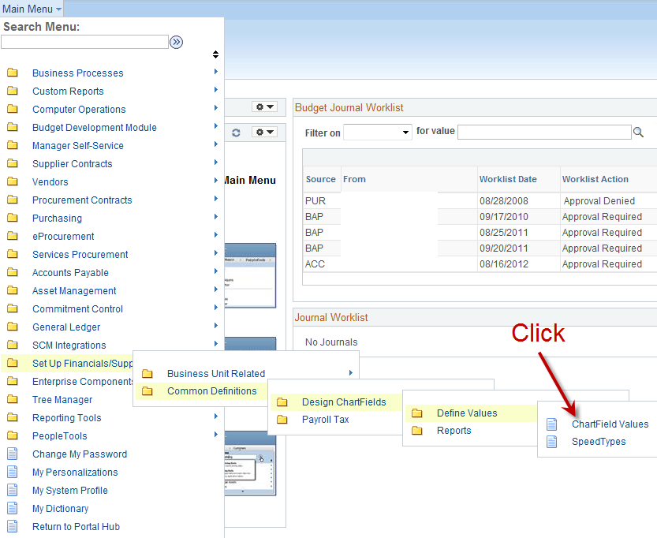
Navigation to Find Endowment Agreement

Slide 18
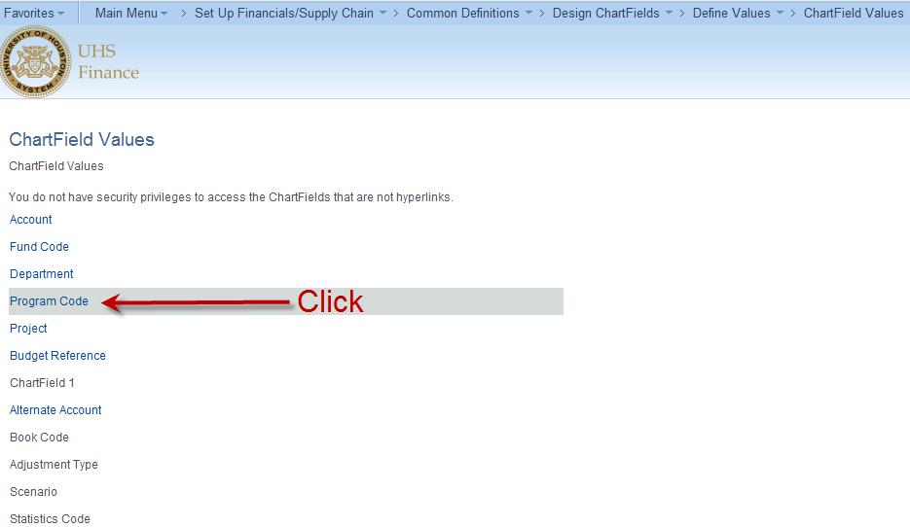
Navigation to Find Endowment Agreement

Slide 19
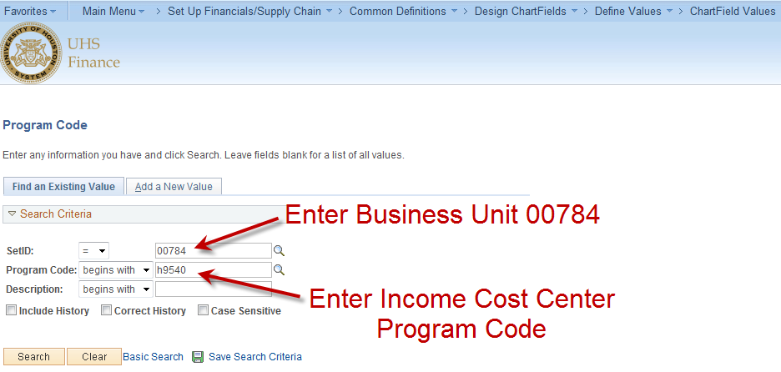
Navigation to Find Endowment Agreement

Slide 20
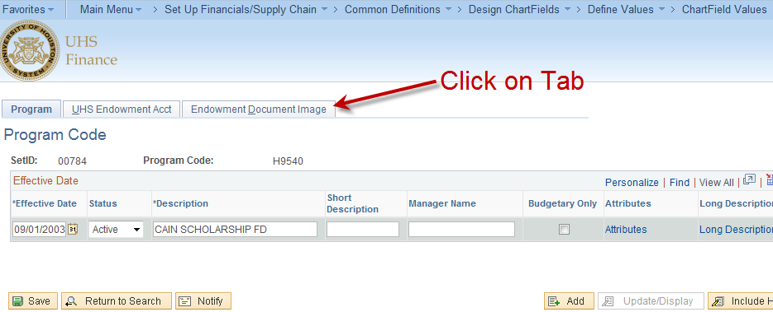
Navigation to Find Endowment Agreement

Slide 21
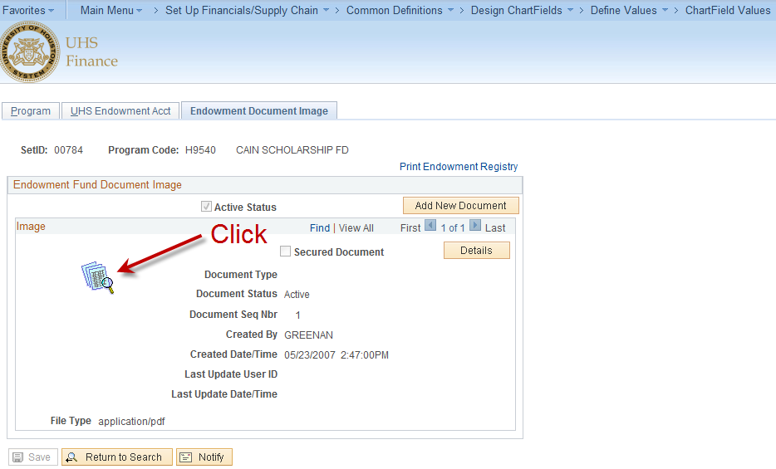
Navigation to Find Endowment Agreement

Slide 22
The End

